Slide 1
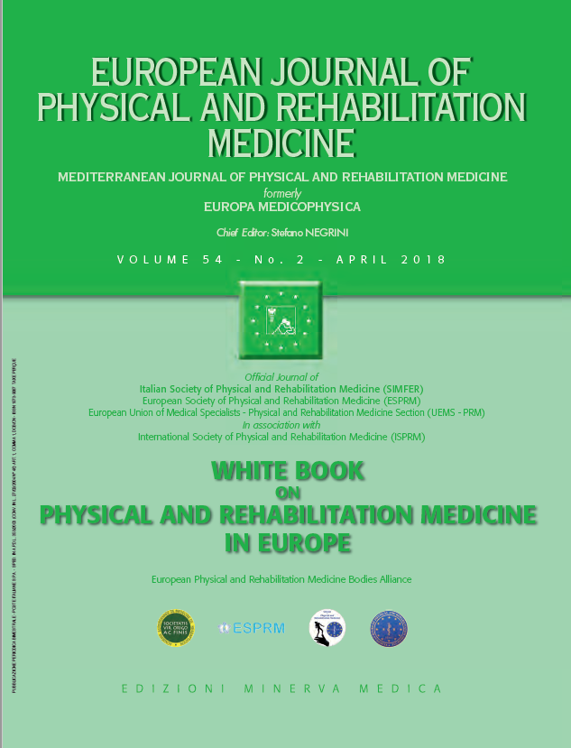
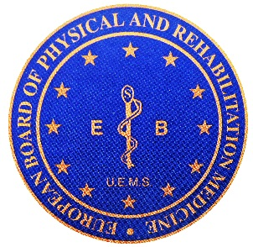
9
PRACTICE OF PHYSICAL AND REHABILITATION MEDICINE IN EUROPE Education and continuous professional development: shaping the future of PRM
European Physical and Rehabilitation Medicine Bodies Alliance. White Book on Physical and Rehabilitation Medicine in Europe. Chapter 9. Education and continuous professional development: shaping the future of PRM. Eur J Phys Rehabil Med. 2018 Apr;54(2):279-286. doi: 10.23736/S1973-9087.18.05153-5.

Slide 2
Introduction
This chapter deals with the education of PRM physicians in Europe.
Undergraduate training of medical students is focused, being considered a mandatory element for the growth of both PRM specialty and the medical community as a whole.
The problems of continuing professional development and medical education are faced in a PRM European perspective.
The principles and the contents of the European curriculum are detailed.

Slide 3
Education and training
PRM practice is uniquely characterized by a team-based, patient-centered, goal-directed approach.
PRM physicians are required to develop not only medical knowledge, competence in patient care and specific procedural skills, but also attitudes towards interpersonal relationship and communication, profound understanding of the main principles of medical ethics and public health, ability to apply policies of care and prevention for disabled people and people with disabling conditions, capacity to master strategies for reintegration of disabled people and people with disabling conditions into society, apply principles of quality assurance and promote a practice-based continuous professional development.
PRM physicians must also exhibit managerial competences, know and apply the principles of evidence-based medicine, incorporate considerations of cost awareness and risk-benefit analysis in patient and/or population-based care as appropriate.

Slide 4
Name of the PRM Specialty in UEMS Member States.

Slide 5
Standards in education and training of PRM physicians
The establishment of a common set of knowledge, skills and competencies for postgraduate training allows to create a Common Training Framework, enabling specialists in that discipline to move from one country to another.
The European PRM Board aims to promote patient safety and quality of care through the development of the highest standards of medical training and health care across Europe and the harmonization of PRM physicians’ qualifications.

Slide 6
Training duration
To acquire the wide field of competence needed, the PRM educational program in Europe is usually configured in 48-month format.
The frequency and complexity of comorbidities in rehabilitation wards have markedly increased - and for this reason, the PRM Board advocates a duration of training of 60 months.
PRM trainees are expected to develop decision-making abilities, based on finding, understanding and using the best available evidence.
It is recommended that PRM trainees are offered at least six months training in research methods.

Slide 7
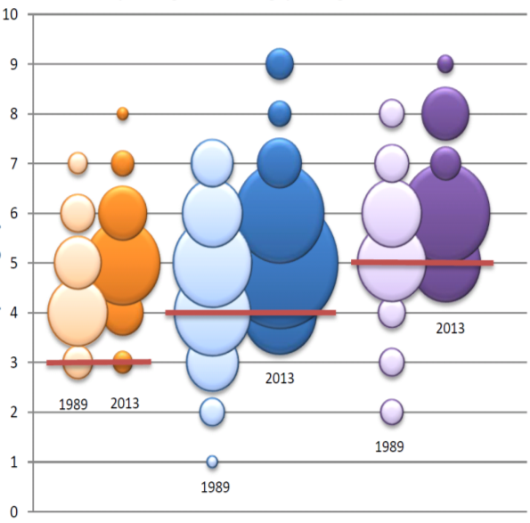
Minimum Minimum Minimum
3 year 4 years 5 years
Distribution of specialties with legal course lasting at least 3, 4 or 5 years, respectively, across different European countries: results from two different surveys conducted in 1989 and 2013.

Slide 8
Directors of training, trainers and training units
Training must be realized in dedicated centers where qualified personnel and adequate resources are available.
The Director of PRM training ensures the quality of didactic and clinical education.
Each trainee must receive supervision by one trainer (a PRM physician) with documented qualification to instruct and supervise residents.

Slide 9
Assessment of learning /training outcomes
The achievement of learning/training outcomes must be assessed at least on an annual basis.
Adequate permanent records of the evaluation must be maintained in the file.
The assessment must be objective and document progressive trainee performance improvement appropriate to their educational level.
The final year examination must verify that the trainee has demonstrated sufficient competence to enter practice without direct supervision.

Slide 10
Certification procedures
Specialists in PRM have freedom of mobility across UEMS member states.
There are currently around 20.000 PRM physicians in Europe and 3.000 PRM trainees; out of 3.897 PRM physicians who have been European Board certified since 1993, 1.094 are active Fellows of the PRM European Board: 260 of them have achieved the status of Senior Fellows; 24 training sites are Board certified centers for PRM education according to the European standard.
The European Board of PRM has a comprehensive specification on several aspects of postgraduate education for PRM-specialists:
curriculum for postgraduate education
a specimen of a training course of at least four years in a PRM department with a uniform official logbook
a single written annual examination
a system of national managers for training and accreditation
standard rules for the accreditation of trainers
quality control of training sites
continuing professional development covering the continuing medical education system
Further information on the regulations of this education and training system can be found on the UEMS PRM Section`s website www.euro-prm.org

Slide 11
Undergraduate training
Medical students will be responsible for the care of patients with disabilities and people with disabling conditions.
Patients treated by virtually all specialties express rehabilitation needs - as a result, all physicians need to gain a basic knowledge of rehabilitation.
It is thus important that well-trained PRM physicians teach PRM in all undergraduate medical faculties and the following topics are required as a minimum:
the principles of PRM and the bio-psycho-social model of ICF
the organization and practice of PRM
the principles and aims of functional assessment and the main adverse factors of functional recovery
the principles and potential of physiotherapy, occupational therapy, (neuro)psychology, speech and language therapy and other rehabilitation therapies
the principles and effects of drug treatments used to improve function, prevent complications, alleviate pain or any other source of discomfort
comprehensive rehabilitation programmes and their main indications
the rehabilitative needs of patients with special conditions
knowledge of the social system and legislation concerning disability and rehabilitation at national level, as well as ethical and human rights issues in rehabilitation

Slide 12
Continuing Professional Development (CPD) and Medical Education (CME)
All doctors have a duty to engage in a continuum of education, training and life-long learning while Continuing Professional Development (CPD) must take account of international innovations and good practices.
CPD and Continuing Medical Education (CME) are an integral part of PRM physicians’ professional practice and involves activities to enhance team building, management, professionalism, interpersonal communication, information technology, teaching, research, peer review, audit and accountability. In this sense, CPD incorporates and goes beyond CME (clinical knowledge).
The UEMS has harmonised its CME accreditation around the European CME Credit (ECMEC), and, via a mutual recognition agreement also in North America.
The UEMS European Accreditation Council of CME (EACCME) is an institution of the UEMS which formally represents European countries.
Obligatory CPD/CME is established in certain countries of Europe and is becoming increasingly required in medical practice.

Slide 13
The international teaching programmes serve to educate PRM physicians and their colleagues in rehabilitation teams.
The CME/CPD programme organised on European level is based on the provisions of the mutual agreement signed between the EACCME and the UEMS PRM Section and Board.
According to this mutual agreement, the National Accreditation Authority of each Member State of the EU (and EEA):
is the relevant authority guiding and controlling the accreditation
is responsible for the relevant programmes within the specialty, for the accreditation of the scientific events at the European level and the scientific status of the Board certified PRM physicians
The first European Board sponsored event has been the European School in Marseille on Posture and Movement Analysis, which was established in 2000.
The Euro-Mediterranean Rehabilitation Summer School started in Syracuse, 2005.
Several e-books with educational content have been published.

Slide 14
Curriculum in PRM: main principles
The different fields of competence and intervention of PRM physicians are typically described by categories taking into account the underlying medical conditions or the impaired body system.
The fields of competence and intervention of PRM physicians should be listed using function-related categories based on ICF.
According to this model, PRM physicians need:
to know the biopsychosocial determinants of health
to have the skill to communicate this to the patient, to the patient’s family and to colleagues and the rehabilitation team
to demonstrate highly person-centred clinical practice

Slide 15
Competencies to be acquired during the training:
clinical and instrumental assessment
knowledge of learning principles/neuroplasticity/repair/recovery
functional assessment in the frame of ICF
implementation of clinical and instrumental assessment tools
prognosis of disease/disability course, detection of adverse/favorable factors of functional recovery and definition of the means (ways) of recovery, compensation and adaptation
devising and conducting a rehabilitation plan, through a team-based approach
prescription, evidence-based as possible of medical and physical treatments
prevention and management of complications
leadership and teaching skills
communication skills appropriate to convey relevant information and explanations to the patient/carers, to colleagues in charge of the patient and other health professionals
commitment to carrying out professional responsibilities and adherence to ethical principles
active cooperation with the public health agencies and other bodies
identification of the health needs of the community
conducting programmes of therapeutic education for disabled people and caregivers
participation in education of physicians and other professionals involved in care for disabled people
implementation of cost awareness and risk-benefit analysis
ability to improve the quality of professional work through continuous learning
ability to apply the basic principles of research

Slide 16
Under the perspective of a disease-centered approach, PRM physicians must develop progressive responsibility in diagnosing, assessing, and managing:
acute and chronic musculoskeletal syndromes, including sports-related injuries, occupational injuries, rheumatologic disorders, post-fracture care and postoperative joint arthroplasty
acute and chronic pain conditions, including use of medications, physical modalities, exercise, therapeutic and diagnostic injections, and psychological and vocational counselling
congenital or acquired amputations
stroke
congenital or acquired brain injury, spinal cord disorders, myopathies, peripheral neuropathies, motor neuron and motor system diseases
pulmonary, cardiac, oncologic, infectious, immunosuppressive, and other common medical conditions
tissue disorders
medical conditioning, reconditioning, and fitness and metabolic conditions..
The postgraduate PRM curriculum details the theoretical knowledge necessary for the practice of the medical specialty of PRM and the core competencies (training outcomes) to be achieved at the end of training.

Slide 17
For this paper, the collective authorship name of European PRM Bodies Alliance includes
European Academy of Rehabilitation Medicine (EARM),
European Society of Physical and Rehabilitation Medicine (ESPRM),
European Union of Medical Specialists PRM section (UEMS-PRM section),
European College of Physical and Rehabilitation Medicine (served by the UEMS-PRM Board).
The Editors: Maria Gabriella Ceravolo, Pedro Cantista, Nicolas Christodoulou, Alain Delarque, Christoph Gutenbrunner, Carlotte Kiekens, Saša Moslavac, Enrique Varela-Donoso, Anthony B Ward, Mauro Zampolini, Stefano Negrini.
The contributors: Maria Gabriella Ceravolo, Wim G.M. Janssen, Jacinta McElligott, Angela McNamara, Calogero Foti, Saša Moslavac, Raquel Valero, Enrique Varela-Donoso, Rolf Frischknecht, Alvydas Juocevicius, Rochelle T. Dy, Alain Yelnik.

