Slide 1

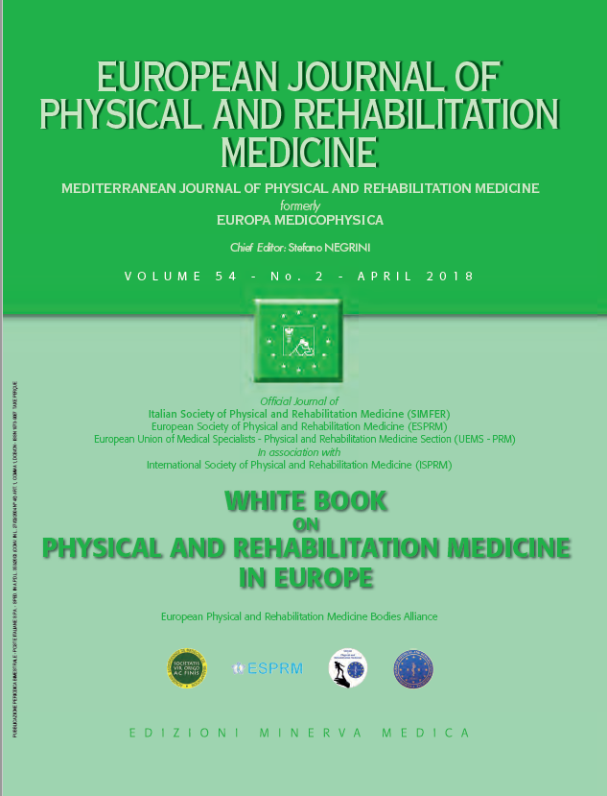
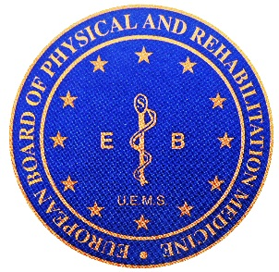

6
PRACTICE OF PHYSICAL AND REHABILITATION MEDICINE IN EUROPE
Knowledge and skills of PRM physicians
European Physical and Rehabilitation Medicine Bodies Alliance. White Book on Physical and Rehabilitation Medicine in Europe. Chapter 6. Knowledge and skills of PRM physicians. Eur J Phys Rehabil Med. 2018 Apr;54(2):214-229. doi: 10.23736/S1973-9087.18.05150-X-X.

Slide 2
Introduction
This chapter deals with the fundamentals of PRM from a physiological perspective, looking at the human mechanisms, both physical and behavioral which are at the base of PRM physicians’ work.
The mechanisms considered include:
  learning processes
  repair processes (and potential of recovery evaluation)
  compensatory processes (adaptation/habilitation/rehabilitation)
  management skills
  communication skills

Slide 3
Evolution driving to the actual fundamentals of PRM
Traditionally, medicine has based its treatments of making etiological diagnosis, setting pharmacological or surgical treatments.
This anatomo-clinical model focuses on the disease and it has shown to be very effective for medical diagnosis and in the context of acute diseases.
This approach is insufficient when there is no cure and the disease results in disability and handicap or activity limitation and participation restriction.
The model known as „functional“ is focusing not on the disease, but on the patient, describing the functioning limitations and environmental factors.
This model is more relevant to the description and analysis of chronic conditions and their treatment.
Therapeutic interventions do not aim to cure the patient only by treating the disease and impairments: they aim also at activity limitations and participation restrictions.

Slide 4
Therefore, the actions of PRM focus on three targets:
  individual, promoting not only the repair (disease and impairments) but also the compensatory processes
  the environment (physical, personal, professional, etc.)
  on individual projects (education, work, personal and social life)

Slide 5
The ICF: a key concept for PRM
The medical specialty of PRM has adopted ICF developed by the WHO.
An example of the application of this approach is the identification of a lesion (etiology), assessment of different body structures and functions, to measure the severity of the impairment and also to make precise correlations between impairments and underlying lesions, the assessment of limitations in activity and the remaining abilities, and the assessment of social consequences of the injury or disease (participation).
ICF also constitutes a good model for rehabilitation strategies.
It must also be considered that the development of the capacity does not correspond necessarily to the final performance of the patient.
This multi-dimensional approach reinforce that PRM may be considered as a medicine of the human person in complementarity with the medicine or specialties of organs.

Slide 6
Learning processes in PRM
Learning is a part of the rehabilitation process.
The principles of adaptation and plasticity are covered in the PRM training programme and PRM physicians learn how individuals learn motor skills and this requires an appreciation of: motor development, motor control, motivation, teaching practice for physical training.
This knowledge equips PRM physicians to design strategies to enhance outcomes and avoid mal-adaptation and in preventing the learned non-use phenomenon and to restore function.

Slide 7
Recovery of function, whether spontaneous or enhanced by therapy, is a dual process of plasticity.
The neuroplastic process depends on the muscle effector activity, while its expression depends on the neurological command and regulation.
PRM physicians thus embrace this new functional concept, to work with therapists, to advance the concepts of both neurological and orthopedic rehabilitation, for instance in action and observation treatments.
PRM clinicians see that repetitive practice is a feature of any intervention as part of motor learning.
PRM physicians prescribe and propose different practice treatment schedules to get around the inadequacies of simple repetition of movement.
To elicit cortical changes (true recovery) individuals should be exposed to more challenging tasks.
Motor learning and repetitive practice is thus used in the stroke and brain injury population and includes: arm ability training, constraint induced movement therapy, electromyography-triggered neuromuscular stimulation, interactive robot therapy, virtual reality-based rehabilitation.

Slide 8
Understanding the repair processes and using the compensatory processes in PRM for adaptation, habilitation and rehabilitation
Motor recovery includes two components: the true recovery ‘per se’ and the compensation.
Compensatory mechanisms are adopted to achieve the best possible functioning (activity and participation) when a complete anatomical recovery is not possible.
Motor learning refers to the capability of the human motor system to learn through practice and experience.
Motor learning includes motor adaptation, skill acquisition and decision-making.

Slide 9
Motor adaptation
Motor adaptation appears as the process able to produce the better plan to minimize the energetic cost and optimize the efficiency of the movement and to maximize performance in environment.
We can emphasize the role of the plasticity of the motor function.
Motor strategies
To achieve a particular goal, we can use more than one motor plan.
Skill depends from motor development and from motor learning.
In PRM field, the patients develop a learning characterized by a re-optimization process considering the new conditions imposed by their impairments.
It is necessary to put forward the idea that rehabilitation has not to be „a particular ideal of health or performance, determined externally“ by the medical team.

Slide 10
Sensorimotor adaptation and cognitive expansion
Motor adaptation may be induced in response to an external perturbation as a sensory conflict induced by prismatic lenses creating a shift of visual environment after repeated rapid pointing movements in the direction of visual targets.
Adaptation can even develop during imagined visuo-manual pointing movements (without any overt execution) during prism exposure.
Therefore, when intersensory spatial discrepancy of the hand location (visual shifted location vs proprioceptive non-shifted location) is available, motor preparation is sufficient to drive realignment.
This visomotor adaptation induced by prismatic exposure can interact with higher brain functions related to multisensory integration.

Slide 11
Prism adaptation. Prism adaptation phases (A): The subject wears a pair of goggles fitted with prismatic lenses creating a rightward optical shift of 10° (Pre-test). A shelf was placed under the patient’s chin to prevent viewing of the hand at its starting position, but allowing an unobstructed view of the targets and terminal pointing errors (suppression of visual feedforward of the movement). At the start of the process, the subject is asked to made rapid pointing movements (suppression of visual feedback of the movement) in the direction of a visual target (Exposure). Pointings movements are shifted to the side of the optical deviation (black arrow) and towards the virtual target (Initial errors). The motor system can then take into account the spatial error consecutive to prism deviation (adaptation), regardless of whether the subject shows phenomenological awareness of the error, and finally compensate for the optical deviation (Compensation). Following removal of the prismatic glasses, when the subject is asked to once again rapidly point towards a target, the movement is shifted in the direction opposed to the optical deviation (leftward: red arrow) (After-effects). The relevant point for neglect rehabilitation is that after a rightward optical deviation of the visual field, subjects thus show a systematic leftward deviation of visuo-motor responses with the adapted limb without implication of voluntary attention of the patient i.e. according to a bottom-up track. Improvement of spatial cognition deficits after prismatic adaptation in right-brain-damaged patients (B): visual neglect in drawing tasks from memory of daisy (1) and by copy (2); representational neglect assessed by mental evocation of map of France (3); auditory neglect assessed by a listening task (4); wheelchair navigation (5) and spatial dysgraphia (6).

Slide 12
Other mechanisms of adaptation
the use of other body structures and functions to vicariate the damaged one
the use of prosthesis/orthosis to compensate the loss of function

Slide 13
Adaptation, habilitation and rehabilitation
Motor adaptation involves sensorimotor interactions solicited in response to an external perturbation or changes in the body, and relied on practice of repeated exercises during a short duration.
Adaptation is learned implicitly without subject awareness, involves long-lasting sensorimotor after-effects, but also cognitive after-effects.
These neurophysiological processes play a different role in rehabilitation (mainly related to the adults) and in habilitation (during growth).
During habilitation, growth can be considered a driving force leading to „natural“ sometimes ineffective or even damaging compensations; but growth can also be a strong force that, if well guided through correct adaptation processes, can lead in time to good compensations producing better functioning than what expected according to the natural history of the original disease.

Slide 14
Potential of recovery evaluation and prognosis in PRM
Functional recovery is the aim of a person after facing a disease, an injury or other health condition.
The rehabilitation plan needs to start determining the premorbid functioning level with the image in mind of the final functioning.
Recovery curves do not follow a linear process, but mainly proceed through a first phase with fast recovery and a second phase with slower improvement.
The length of the first phase is different in the various pathologies, and it is considered the most important for rehabilitation: most of PRM efforts should focus on this phase (post-acute rehabilitation).
The prognosis is only partly based on natural history of the original disease: comorbidities must also be considered, and personal and environmental factor as barriers and/or facilitators of recovery.
Nevertheless, in times of shrinking resources, it is mandatory to set appropriate goals for each patient.

Slide 15
In a purely „compassionate” model, rehabilitation is not denied to anybody; in an exclusively „disease-centered” model, rehabilitation is not given, since the patient is believed able to recover spontaneously without any intervention as soon as the disease has been treated.
In a modern approach, though, rehabilitation should be given to patients really able to improve, in a specific period of time of the health condition, with a start and an end of treatment (to be followed by maintenance, also called postrehabilitation).
Highly specific to PRM is the problem of communicating to patients the expectations (prognosis) due to medical factors.
Reaching a consensus of the aims of rehabilitation agreed by patient/ proxy and medical team can be stressing.

Slide 16
PRM physicians play an important role in the rehabilitation process, since they have been trained into the development of skills to lead multi-professional teams, closely collaborating with other disciplines and have the capacity to give a throughout assessment of the complex functional status of the patient and the possibilities of acquiring a certain outcome in the future.
It also faces with the responsibility of providing an image of the potential value of functional status to plan needs for the future, determine provision of services and allocation of resources of treatment.
In the current times in which health resources are limited, it is very important to give the accurate scientific evidence of the rehabilitation methods and its impact in the patient, their families, and the society.

Slide 17
Management skills
Being good PRM physicians requires excellent technical, scientific but also management skills.
In the 21st century, medicine faces several challenges such as:
  the shift from the paternalistic approach of medicine to a patient-centered approach
  the rise of new tests, new treatments, new drugs and the increase of longevity
  there is a trend to focus towards improving health care not only in medical results but in measuring quality of care, transparency, and efficiency

Slide 18
PRM physicians treat patients who often have complicated conditions such as polytrauma, spinal cord injury, traumatic brain injury or chronic pain.
They work leading multi-professional teams working in a collaborative way, in which good communication and coordination is essential for success.
They also deal with the higher expectations of recovery by patients and their families.
Many of the above-mentioned diseases with the scientific and technological advances become chronic conditions which increase the demand of constant need for physiotherapy, occupational therapy or speech therapy.

Slide 19
In this context, the need of good leadership adapted to the current societal changes and way of thinking is mandatory, otherwise there would be a management failure.
Physicians need to learn having a macroscopic view on health provision and resource allocation.
This implies a need to learn and understand the political, economic, and social environment of the system as well as an ethical based decision making process.
A PRM physician should actively take part in the design of healthcare pathways for the provision of care of people with disabilities and develop clinical guidelines to recommend treatments across the continuum of care.

Slide 20
Within a rehabilitation service, at the meso-level, the PRM physician should develop management skills to build an effective team: good communication skills, the ability to encourage different members of the team to participate and join in, suggest aims and objectives of treatments, avoid personal criticism and reach the final aim through a majority consensus.
Team meetings should result in the establishment of a care team individualized plan with specific objectives, with the determination of the clinical interventions, duration of treatment and assignment of duties.
The PRM physician should be able to detect and arbitrate over conflicts that can emerge among the different team members and should be able to handle it in a successful way.

Slide 21
At the micro-level, the challenge for PRM physicians is strictly related to patients’ long-term management: long term care, including home adaptations, long-term and post-rehabilitation care, adapted physical activity, continuous counselling.
Many patients needing rehabilitation may move through a series of PRM facilities and services.
PRM physicians should be able: to develop good management skills within the reference of the needs of the current state of medicine and health care systems, to lead the multiprofessional team working in a collaborative way with other disciplines, to bring primary and secondary goals of rehabilitation together, plan interventions, delegate tasks for the different members of the team and communicate in an effective and empathic way to patients and their families, to manage patients in the long term, as well as in the short term in their individual pathways of care throughout different rehabilitation facilities.

Slide 22
Communication skills (including information and patient education)
Effective communication with patients and their caregivers, as giving adequate information and providing health education, play a central role in rehabilitation and is a determinant skill for PRM physicians.
Core aims of communication between patient and rehabilitation team include fostering of relationships, exchange of information, enhancement of the patient and caregivers participation in decision making, enabling of self-management, responding to emotions, and managing of uncertainty.
Good collaboration within the multiprofessional team helps to avoid redundant and incoherent information.
PRM physicians should be trained on how to give information that may contradict the patient’s initial expectations.
In the decision-making process, the perspective of a person experiencing or likely to experience disability allows integrating a multitude of factors with the aim of opening a constructive discussion about the life plan.

Slide 23
Patient education
An important role of the PRM physician is to respond to the patient’s demand for comprehensive information on the actual evidence of some methods that are well advertised, though usually with poor evidence.
Dimensions of patient education include:
  knowledge, perception and beliefs of one’s health condition
  problem-solving abilities
  health locus of control and perceived self-efficacy
  health behaviors
  coping strategies

Slide 24
Families/caregivers play an important role in education of the patients.
Interventions addressing families of patients with severe disability usually consist of individual counselling, education, and group support.
Timing in delivering educational content is important. This also applies to giving information to the patient and caregivers.
In early rehabilitation, when biomedical themes are prevalent, educational goals should mirror the therapeutic process.
Psychological and medico-social aspects targeting health-related behaviors, every-day habits, vocational education, learning social skills should be commenced in post-acute rehabilitation.
During the chronic phase, education contents should cover socially important issues as well as prevention of secondary conditions.
Long-term goals of patient education usually include: social integration, independence, improved health risk profile, maintenance of physical and vocational activity, custom of protective health behaviors, retention of adequate knowledge of the health condition, realistic expectations regarding outcome, active attitude towards therapy.

Slide 25
All team members are responsible for carrying out elements of patient education per their fields of competence. The PRM physician, as team leader, is responsible for coordination of the educative process, including delivering crucial information.
Educative methods should be adapted to the patient’s experience and most common psychological profiles typical for a given health condition.
The process of education should consist in the identification of learning barriers, gain of both knowledge and practical skills, evaluation, and positive reinforcement.
Application of modern educational methods and materials should correspond with methods used in biopsychosocial interventions.
PRM societies and rehabilitation centers should publish educational evidence-based resources.
Peer participation in patient education is increasingly popular.

Slide 26
The effect of education appears to be more evident in complex patients.
Health-related and personal factors hindering the efficacy of communication and patient education comprise speech, language, comprehension, perception and memory deficiencies, poor anger control, depression, history of learning disability, abuse, chronic pain.
Intractable health conditions cannot always be addressed per patient’s demands.
Among environmental factors decreasing the efficacy of patient education the most important are lack of social support and health provider related factors: availability unmatched with the time when the patient and caregivers fully understand their educational needs, being less cooperative or using controlling behavior, lack of adequate knowledge or non-compliance with guidelines, negative attitudes and beliefs concerning a subject of education, providing the patient with inadequately good feeling about his health.

Slide 27
For this paper, the collective authorship name of European PRM Bodies Alliance includes
European Academy of Rehabilitation Medicine (EARM),
European Society of Physical and Rehabilitation Medicine (ESPRM),
European Union of Medical Specialists PRM section (UEMS-PRM section),
European College of Physical and Rehabilitation Medicine (served by the UEMS-PRM Board).
The Editors: Stefano Negrini, Pedro Cantista, Maria Gabriella Ceravolo, Nicolas Christodoulou, Alain Delarque, Christoph Gutenbrunner, Carlotte Kiekens, Saša Moslavac, Enrique Varela-Donoso, Anthony B Ward, Mauro Zampolini.
The contributors: Jean-Pierre Didier, Sara Laxe, Gilles Rode, Piotr Tederko, Carine Michel, Jean Paysant, Yves Rossetti, Anthony B Ward, Nino Basaglia, Walter Frontera, Andrew J. Haig, Leonard Li, Jianan Li, Luca Padua, Dominic Pérennou.

