Slide 1

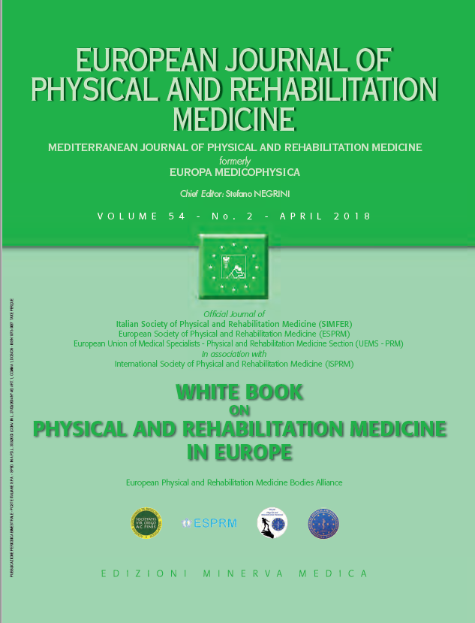
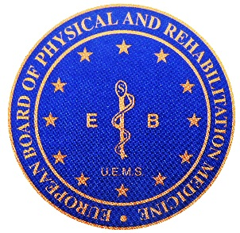

5
ORGANIZATION OF PHYSICAL AND REHABILITATION
MEDICINE IN EUROPE
The PRM organizations in Europe: structure and activities
European Physical and Rehabilitation Medicine Bodies Alliance. White Book on Physical and Rehabilitation Medicine in Europe. Chapter 5. The PRM organizations in Europe: structure and activities. Eur J Phys Rehabil Med. 2018 Apr;54(2):198-213. doi: 10.23736/S1973-9087.18.05149-3..

Slide 2
Introduction
The organization of Physical and Rehabilitation Medicine specialty in Europe has been developed in the years to allow on one side to improve the actual practices, and on the other to make them uniform in the various European countries.
In this chapter, the activities and programs of all the European relevant organization are presented.
  The European PRM Bodies joined for this third edition of the White Book to form the European PRM Bodies Alliance.
  The Regional Fora: the Mediterranean Forum of Physical and Rehabilitation Medicine and the Baltic and North Sea Forum of Physical and Rehabilitation Medicine
  The National PRM Societies in Europe
  The European multinational PRM Journals

Slide 3
The Section of Physical and Rehabilitation Medicine of the European Union of Medical Specialists (UEMS)
Specialty was officially recognized in 1968, and in 1971 the UEMS approved the creation of a Section under this name.
Since 2001 the Section was reorganized to serve the multiple needs of the specialty within the European Union (www.euro-prm.org).
It was divided in three committees:
  The Board (PRM Training and Education Committee)
  The Clinical Affairs Committee (for defining and accrediting the quality of clinical care in PRM)
  The Professional Practice Committee (for defining and protecting the Field of Competence of the PRM physicians)

Slide 4
The Board and the Training in PRM
Since 1991, the educational affairs of the Section were given to the newly established Européenne College de Médecine Physique et de Réadaptation Fonctionnelle, to act as the European Board.
The route to start training is slightly different in each country but despite different entry points to the specialist training program, the curriculum has much similarity across the continent.
The European Board of PRM has the task of harmonizing specialist training across Europe and has taken on the following roles:
  European examination for recognition of specialist training leading to a fellowship
  Continuing medical education & professional development used for ten-yearly revalidation of fellowship
  Recognition of European trainers & training units through site visits
The eventual aim of this harmonization is to produce specialists who can work across European health care systems.

Slide 5
The Clinical Affairs Committee (CAC) deals with the Quality of Care in PRM
This committee sets up the procedure for European Accreditation of PRM Programs of Care; the only goal of this accreditation is to make people throughout Europe aware of the quality of PRM care proposed in Europe and to develop a European PRM culture of quality.
The „Programme of care in PRM“ is the structuring unit for describing the activities of our discipline, the evaluation of its results, and the negotiations for its financing.
Also, an ongoing process in the CAC is to define minimum required European guidelines for clinical practice.

Slide 6
The Professional Practice Committee (PPC) deals with the fields of competence related to PRM
The primary objective of the PPC was to insure a single officially -recognized appellation for the PRM specialty in Europe.
Section was able to obtain a vote on an amendment to the European definition of the Medical Act, adding the words „functioning“, „rehabilitative“ and „ethical“.
The PRM Section of the UEMS decided to encourage the use of ICF in clinical practice.
As soon as the PPC was created in 2001, its members began writing a second White Book.

Slide 7
Members
Full membership have the 28 European Union members along with Switzerland, Norway and Iceland. Israel, Serbia and Turkey are associate members. Several other European countries are observers (Montenegro, Former Yugoslav Republic of Macedonia (FYROM), Bosnia & Herzegovina, Georgia, Armenia, Russia, Ukraine). There are over 23.000 trained specialists and trainees.
The general structure of PRM services across Europe is similar despite the differences between healthcare systems.
Proposals for clinical standards are being put together: for example the creation of European Standards of Practice for patients in post-acute setting, the European card for patients with autonomic dysreflexia as well as the e-book on the field of competences part I and part II, the latter now in progress.

Slide 8
European Society of Physical and Rehabilitation Medicine [ESPRM] (www.esprm.net)
The mission of ESPRM is:
  to be the leading scientific European society for physicians in the field of PRM
  to improve the knowledge of fundamentals and the management of activities, participation and contextual factors of people experiencing or likely to experience disability
  to improve and maintain a strong connection between research and clinical practice in PRM
The ESPRM has membership from both individual members who are PRM physicians or from national PRM societies. Nowadays (2017), the latter are 35 in number.

Slide 9
The following Special Interest Scientific Committees (SISC) have been established:
  Public Health
  Orthotics and Prosthetics
  Guidelines
  Persons with Pain and Disability Persons with Parkinson / Movement disorders
  Persons with Traumatic Brain Injury
  Persons with Musculoskeletal Disorders
  Sports Affairs
  Robotics in Rehabilitation
  PRM in Ageing Persons
  Evidence Based Medicine
  Persons with Spinal Cord Injury
  Persons with Stroke
  Ultrasounds in PRM
  Persons with Peripheral Nerve Disorders
The following Congresses were held by the ESPRM:
Vienna 2004
Madrid 2006
Brugges 2008
Venice 2010
Thessaloniki 2012
Marseille 2014
Estoril 2016
Vilnius 2018

Slide 10
Académie Médicale Européenne de Médecine de Réadaptation / European Academy of Rehabilitation Medicine (EARM) (www.aemr.eu)
The mission is to:
  improve all aspects of the rehabilitation of disabled people
  be a reference point in the scientific, educational and humanitarian aspects of PRM
  engage in moral and ethical debate
  exchange information defining the field of rehabilitation and its terminology
  ensure that education in rehabilitation is part of the CV
  support and help improve research in rehabilitation
  introduce and defend the concept of rehabilitation
  facilitate exchange of PRM trainees and doctors between different countries

Slide 11
Some works on ethics are:
  the ethical problems posed by the longer survival of a greater number of people who are entirely dependent and conscious
  revealing the prognosis to a paralysed adult
  ethical problems posed by sexuality for persons with disabilities living in institutional establishments
  violence and handicap, published as a brief communication

Slide 12
Books published in Academy’s Collection:
  La Plasticite de la Fonction Motrice / The Plasticity of Motricity Function; by J.P. Didier. Springer. 2004
  Sphincter Functioning / Les fonctions sphinctériennes. by Amarenco G. Chantraine A. (Eds.) (2006)
  Vocational Rehabilitation by Gobelet Charles. Franchignoni Franco (2006)
  Rehabilitation and palliation of cancer patients (Patient care) by Hermann Delbruck (2007)
  Rethinking physical and rehabilitation Medicine
  New technologies induce new learning strategies by Didier Jean-Pierre Bigand Emmanuel (2010)
  Assessment in Physical Medicine and Rehabilitation: Views and Perspectives by M. Barat and F. Franchignoni (2005)
EARM has created an annual Academy prize to a publication in the PRM field.

Slide 13
The Regional Physical and Rehabilitation Medicine (PRM) Fora:
The Mediterranean Forum of Physical and Rehabilitation Medicine – MFPRM - was created at the 3rd Congress in Athens in 2000 and its members are individual PRM physicians from Mediterranean countries or countries in close vicinity.
Baltic Forum started in 2003 and decided to include also the North Sea area into the Forum. It is a region with 16 countries having different languages and traditions as well as different health systems. It is registered in Latvia.

Slide 14
The main goals of BNF-PRM and MFPRM are:
to communicate and exchange knowledge in the field of PRM
to create and evaluate concepts for PRM activities and discuss best practice
to stimulate creation of networks for scientific projects regarding different aspects of rehabilitation research, multicenter trials and projects
to support education and training in the field of PRM and facilitate exchange of young doctors and scientists
to influence national governments and incorporation of issues of rehabilitation into national health strategies
to give opportunity for personal contacts
to have a collaboration and a good cooperation with National and International scientific PRM bodies.
Both Fora organise scientific congresses and summer schools for PRM residents and young specialists.
The „European Journal of PRM“, with the sub-title of „Mediterranean Journal of PRM“, is the MFPRM`s official journal and the „Journal of Rehabilitation Medicine“ is the official journal of the BNF-PRM.
The MFPRM website is www.mfprm.org ; the BNF-PRM website is www.bnfprm.org.

Slide 15
National PRM Societies in Europe
In Europe, the national societies play a pivotal role in the development of PRM.
The role of the European Bodies is to harmonize the PRM practice and education across Europe, and the national societies for carrying out the implementation of the European standards according with their specific local experience.
PRM is recognized as a core service in each of the member states of the Greater European space and the newer associate and observing countries also adopt the same principles.
The ESPRM had 17.238 active members from the NSs in 2016. Within the European countries, there are 20.655 PRM physicians.
The number of PRM physicians per 100.000 inhabitants also varies in the different countries - from 10.4 (in Estonia) to 0.2 (in Ireland, Malta and UK).
Most NSs issue their own scientific journal.

Slide 16
The main goal of the National PRM societies is to promote the development of PRM and ensure good rehabilitation care to persons experiencing or are likely to experience disability, to promote the specialty of PRM and the profession of PRM and to develop the rehabilitation services.
That includes:
propagation of the development of a scientific knowledge
professional development of the specialists
defending the professional interests of PRM physicians
defining the competences of PRM physicians, their relations with the other members of the team, with the other medical physicians and other health professionals
focus on creating clinical guidelines, clinical standards of good practice
to organize regular scientific events in PRM
The strength of the societies is that they involve growing number of PRM physicians devoted to the development of PRM.
The weakness usually includes low or difficult communication with the government and with financing providers.

Slide 17
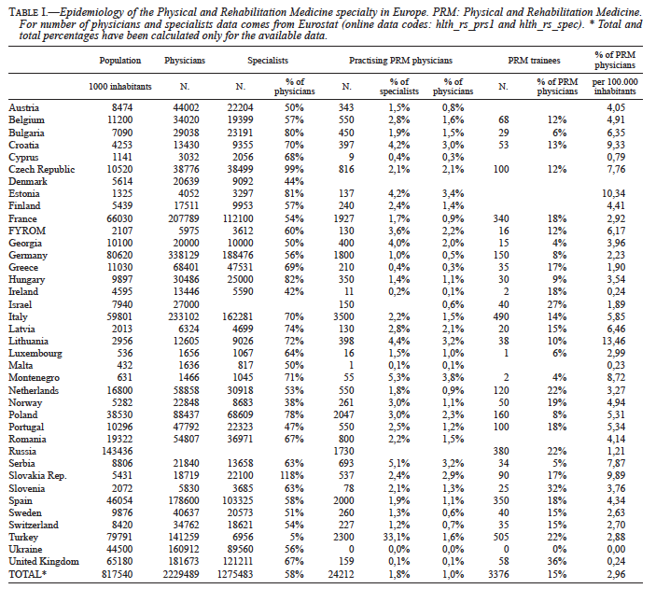

Slide 18
PRM scientific Activities and their representation in Europe – European PRM Multinational Scientific Journals
Scientific journals are key actors of PRM in Europe, since they serve for the development of science and research in our field.
While Europe as a whole is different from other continents, still there are differences between north and south, but also west and east of Europe.
Initially, „Core PRM Journals“ in Europe according to specific and strict criteria were:
  Journal of Rehabilitation Medicine
  Clinical Rehabilitation
  Disability and Rehabilitation
In 2013, the list expanded to include 2 more European journals:
  European Journal of Physical and Rehabilitation Medicine
  International Journal of Rehabilitation Research
European Network of National Journals have been created. All European Bodies have their official Journals.

Slide 19
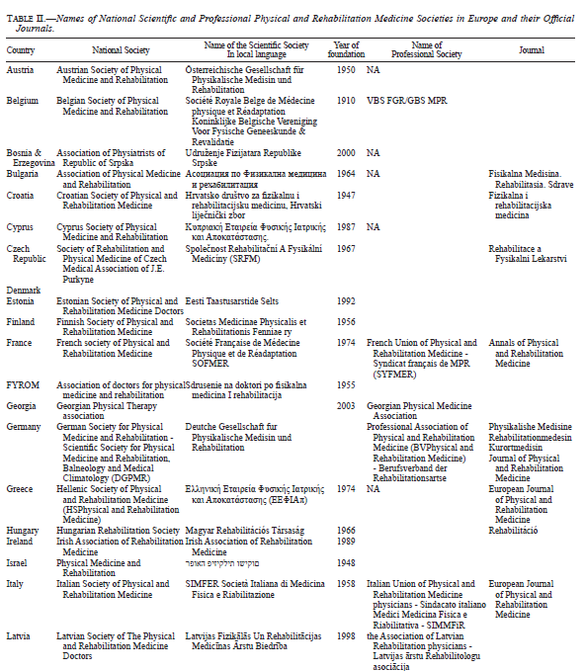
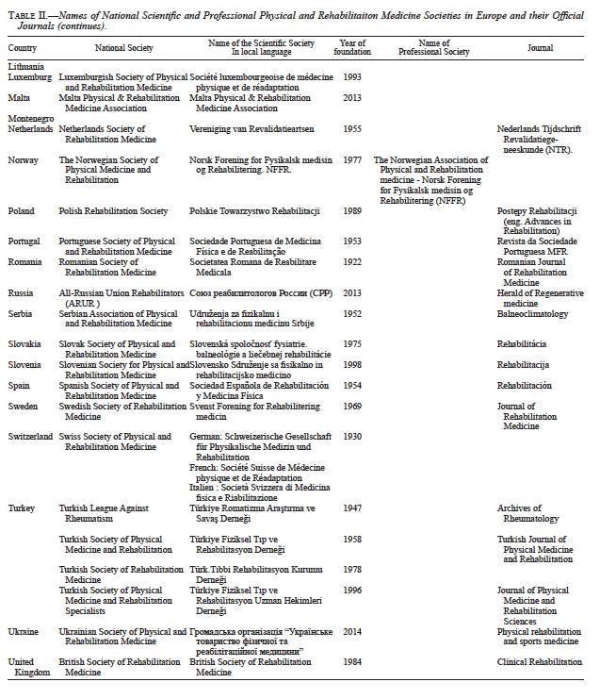

Slide 20
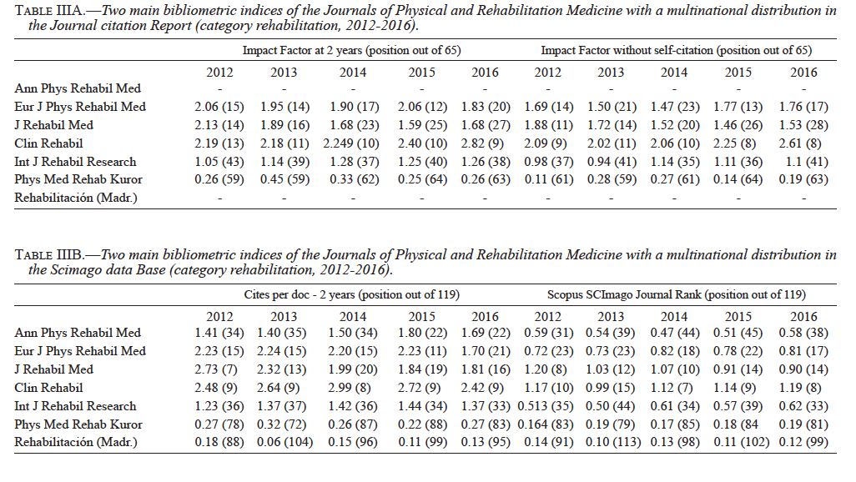

Slide 21
Annals of Physical and Rehabilitation Medicine (APRM) – Official Journal of UEMS-PRM Section
The Journal is indexed in MEDLINE, Web of Science, and SCImago.
Categories of papers include: original clinical, epidemiological and research articles, review articles, editorials and guidelines.
At the discretion of the Editor in Chief, 20-30% of published papers are immediately put in free access.
All papers are in free access at one year.
Publications in the Annals of PRM are free of charge.

Slide 22
European Journal of Physical and Rehabilitation Medicine (EJPRM) – Official Journal of ESPRM and UEMS-PRM Section and Board
The Journal is indexed in CINAHL, Current Contents/Clinical Medicine, EMBASE, PubMed/MEDLINE, Science Citation Index Expanded (SciSearch), Scopus.
Categories of papers include: original articles, systematic reviews and meta-analysis, guidelines, special articles, case reports and letters.
It regularly co-publishes Cochrane reviews and a Cochrane Corner.
Areas of interest: clinical papers in all PRM subspecialties.

Slide 23
Journal of Rehabilitation Medicine (JRM) – Official Journal of UEMS PRM Board and EARM
The Journal is indexed in MEDLINE.
Areas of interest: functional assessment and intervention studies, clinical studies in various patient groups, methodology in PRM, epidemiological studies on disabling studies and reports on vocational and socio-medical aspects of rehabilitation.

Slide 24
Clinical Rehabilitation (CR)
The Journal is indexed (among the others) by ASSIA, CINAHL, Current Contents / Clinical Medicine, EMCare, MEDLINE, PsycINFO, Science Citation Index, Scopus.
Categories of papers include: original papers, systematic reviews, Rehabilitation in Practice articles.
Areas of interest include: goal setting, describing interventions evidence based for rehabilitation, theoretical base for rehabilitation.
It covers functional disorders, all ages, every intervention and all methods.

Slide 25
International Journal of Rehabilitation Research
The Journal is indexed in PubMed/MEDLINE, Science Citation Index Expanded, Social Sciences Citation Index, Current Contents (Social & Behavioural Sciences and Clinical Medicine), Scopus, SCImago, Engineering information and PsycINFO.
Areas of interest: functioning and disablement throughout the life cycle; rehabilitation programs for persons with physical, sensory, mental, and developmental disabilities, measurement of functioning and disability, special education and vocational rehabilitation, equipment, access and transportation, information technology, independent living, consumer, legal, economic and socio-political aspects of functioning, disability and contextual factors.

Slide 26
Physikalische Medisin – Rehabilitationsmedisin – Kurortmedisin - Journal of Physical and Rehabilitation Medicine (JPRM)
The journal is indexed in Scopus and Science Citation Index Expanded.
Areas of interest: scientific and educational articles both in physical medicine and rehabilitation.

Slide 27
Rehabilitación (Madr.) (RM)
The Journal is indexed in Eventline, Bibliomed, Sedbase, Cumulative Index to Nursing and Allied Health Literature (CINAHL), Scopus, Pascal and Indice Bibliográfico Español en Ciencias de la Salud (IBECS).
Its main goal is to provide evidence basis to improve interdisciplinary rehabilitation care.
The scope of the journal includes clinical and basic research papers on rehabilitation field that may improve knowledge and skills of the readership.
The journal is mailed to all SERMEF members (which are more than 1700 professionals).

Slide 28
Disability and Rehabilitation
„Disability and Rehabilitation“ seek to encourage a better understanding of all aspects of disability and to promote rehabilitation science, practice and policy aspects of the rehabilitation process.
It also has sections on Rehabilitation in Practice, Perspectives in Rehabilitation and Case Studies along with Papers focused on assistive technology; submissions covering a wide range of topics on disability and rehabilitation from researchers and practitioners across all disciplines working in the field are encouraged.

Slide 29
The role of Europe in PRM activities across the world
The umbrella organization of PRM physicians worldwide is the International Society of Physical and Rehabilitation Medicine (ISPRM).
ISPRM relies first on its memberships which includes members of national societies, including all European PRM societies as well as individual members.
ISPRM collaborates with regional bodies, including in Europe: EARM, ESPRM, UEMS PRM Section, with other NGOs and with WHO.
The basis of the official relationship with WHO is a mutually agreed three-year plan for collaboration, for which once every three years the WHO executive Board reviews the results.

Slide 30
The most important current topics of the collaboration work plan include:
the system-wide implementation of ICF in PRM
the establishing of learning health system across countries worldwide exemplified for the situation of persons living with Spinal Cord Injury
the strengthening of rehabilitation services worldwide
the development of National Rehabilitation Quality Management Systems including the specification of rehabilitation services applying ICSO-R, Clinical Assessment Schedules, implementation of culturally adopted versions of the clinical assessment schedules tool and the development of metrics for the standardized reporting of data
8 journals that are active members of „ISPRM web of Journal“.

Slide 31
Pathways of political influence on the World Health Organization (WHO) by a non-governmental organization (NGO) in official relation.
CTS: Classification, Terminology and Standards; DAR: Disability and Rehabilitation; ISPRM: International Society of Physical and Rehabilitation Medicine; WHA: World Health Assembly.
Adapted from: Reinhardt JD, von Groote PM, Delisa JA, John L, Bickenbach JE, Li LSW. Chapter 3: International non-governmental organizations in the emerging world society: the example of ISPRM. J Rehabil Med Preview, 2009;(6), 810-22. http://doi.org/10.2340/16501977-0430

Slide 32
For this paper, the collective authorship name of European PRM Bodies Alliance includes
European Academy of Rehabilitation Medicine (EARM),
European Society of Physical and Rehabilitation Medicine (ESPRM),
European Union of Medical Specialists PRM section (UEMS-PRM section),
European College of Physical and Rehabilitation Medicine (served by the UEMS-PRM Board).
The Editors: Mauro Zampolini, Pedro Cantista, Maria Gabriella Ceravolo, Nicolas Christodoulou, Alain Delarque, Christoph Gutenbrunner, Carlotte Kiekens, Saša Moslavac, Enrique Varela-Donoso, Anthony B Ward, Stefano Negrini.
The contributors: Nicolas Christodoulou, Elena M. Ilieva, Jorge Lains, Gerold Stucki, Stefano Negrini, Filipe Antunes, Nikolaos Barotsis, Kristian Borg, Joaquim Chaler, Christoph Gutenbrunner, Črt Marinček, Xanthi Michail, Dominic Pérennou, Henk J. Stam, Ulrich Smolenski, Peter Takáč, Aivars Vetra, Jiri Votava, Derick T Wade, Daniel Wever, Mauro Zampolini, Hermina Damjan, Calogero Foti, Francesca Gimigliano, Jolanta Kujawa, Alessandro Giustini, Caterina Pistarini, Anthony B Ward, Alain Yelnik.

