Slide 1
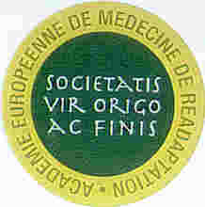
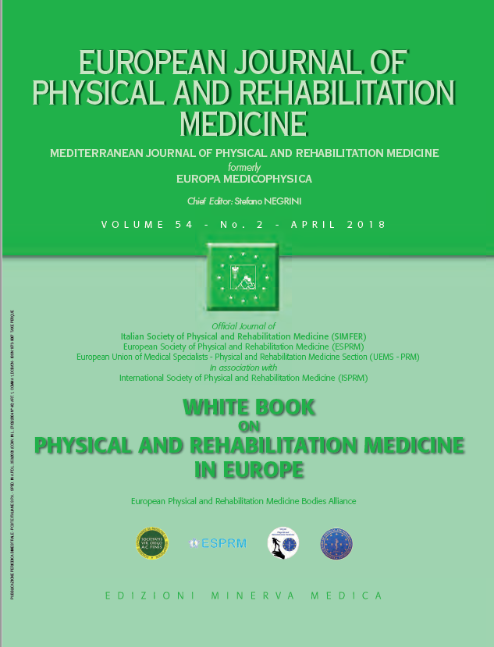
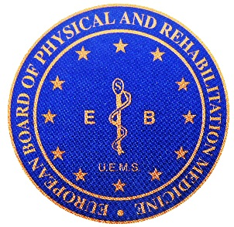

BACKGROUND OF PHYSICAL AND REHABILITATION MEDICINE
A primary medical specialty: the fundamentals of PRM
3
European Physical and Rehabilitation Medicine Bodies Alliance. White Book on Physical and Rehabilitation Medicine in Europe. Chapter 3. A primary medical specialty: the fundamentals of PRM. Eur J Phys Rehabil Med. 2018 Apr;54(2):177-185. doi: 10.23736/S1973-9087.18.05146-8.

Slide 2
Introduction
Core concepts of the PRM specialty are in fact the essential constituents that makes:
  PRM a primary medical specialty, different from other medical specialties
  PRM physician the primary medical specialist among the rehabilitation professionals
It includes:
  PRM is a person/functioning oriented specialty, different from the organ/disease oriented
  PRM physicians have medical responsibilities, with an additional specificity of making a functional assessment
  PRM physicians provide direct treatments, but they also work leading the multi-professional rehabilitation team
  PRM has a multimodal approach including a wide variety of treatment tools (frequently provided by other rehabilitation professionals) and manages all persons’ morbidities (health conditions)
  As PRM bases its work on functioning, it has a transversal role to other specialties: it overlapse with them, but it is also totally independent
  PRM is focused on the person and neither on the disease nor on the setting

Slide 3
The person/functioning oriented versus disease oriented approach in PRM
Traditionally: organ-based approach led to the classical “biomedical model” of treatment, where the search for etiology and pathoanatomy/physiology of a disease is considered the way to develop a good therapy, to eradicate the cause of illness and cure the patient.
The focus of PRM from the start has been the achievement of the best possible „functioning“ in a long-term health condition.
The classical biomedical model was not applicable to PRM.
A breakthrough came through the International Classification of Impairments, Disabilities and Handicaps (ICIDH) and, following this, with the International Classification of Functioning, Disability and Health (ICF): the „bio-psycho-social model“ of treatment was developed.
PRM is focused in general on functioning and disability reducing „activity limitations“, and improving „impairments“, while addressing also „participation restrictions“.
It is mandatory for PRM physician to perfectly know the medical diagnosis and to strongly interfere with the „contextual factors“.

Slide 4
The following points generally distinguish the person-centered approach of PRM from the disease-oriented of the organ based specialties:
  a comprehensive bio-psycho-social approach
  final aim to positively influence and finally improve participation
  taking patients’contextual factors into account: facilitators and/or barriers
  ensuring a focus on optimal participation is high on patients’aims
  the underlying health condition is the context of a PRM program
Furthermore:
  PRM interventions are different around the world
  specialty is focused on functioning and disability, „holistic“ by definition
  PRM today has transversal knowledge (person oriented) and vertical application (disease oriented): there are many possible approaches in clinics
The two possible extremes:
  the „general PRM physician“ – in acute wards and post-acute inpatients practice in general PRM wards
  the „specialized PRM physician“: in patients with specific diseases (in tertiary PRM wards, research and university)
Among these two extremes, all possibilities exist in PRM practice today.

Slide 5
The organ-based approach of the classical „biomedical model“ of medicine.
The International Classification of Impairments, Disabilities and Handicaps (ICIDH) model.

Slide 6
The International Classification of Functioning, Disability and Health (ICF) model.

Slide 7
According to the „biomedical model“, the classical „organbased“ medical specialties are mainly focused on the disease, as well as on the body structures and functions.

Slide 8
The „functioning-based“ PRM specialty is focused in general on functioning and disability (that in fact is all the person); PRM clinical work has a specific focus on reducing „activity limitations“, and improving „impairments“, while addressing also „participation restrictions“ at a micro-level (personal), while the meso- and macro-levels can be addressed, with the expert help of PRM physicians, by those who work on society at large, including educators and politicians or other decision makers. In doing so, it is mandatory for PRM physician to perfectly know the medical diagnosis („health condition“ and „disease“), and to strongly interfere with the „contextual factors“ („personal“ and „environmental“). The best possible „participation“ for the individual is the final goal.

Slide 9
Diagnostic responsibilities of PRM physicians
Rehabilitation is a medical strategy aimed at enabling people experiencing disabilities to achieve optimal functioning in interaction with the environment.
The medical diagnosis:
  forecasts a range of possible residual impairments, activity limitations and also participation restrictions
  does not define the level of these impairments, limitations and restrictions: they will be the results of the rehabilitation process together with the personal and environmental factors.
At the start of the rehabilitation process, it is necessary for the patient and his/her family/caregivers to accept the patient’s new „status“. This will then interact with his or her personal and environmental factors to set and determine the outcomes of the rehabilitation process.

Slide 10
Consequently, PRM physicians have a major medical diagnostic responsibility:
Typically when the patient`s impairment is mild the PRM physician is the first health professional to see the patient and arrive at the diagnosis
In other clinical situations, typically in post-acute wards, PRM physicians are called in after the intervention of other specialists:
  to check and confirm the patient’s primary medical diagnosis
  to identify any comorbidities and already known impairments and activity limitation
Patient followup in the medium and long-term sometimes allows a refining of the medical diagnosis, when the course of the condition does not follow its usual expected pattern.

Slide 11
Apart from the general medical diagnosis, the PRM physician is specifically responsible for:
  the functional assessment of patients
  identifying the impairments and activity limitations
  setting the goals of the PRM program
  elicit the meaning of an illness or a disability to an individual patient, the impact on their sense of personal identity and the resulting emotional reaction
Parts of the functional assessment can also be done by the other rehabilitation professionals, but PRM physicians importantly perform it for all the domains of body structures/functions and activities.
The functional assessment is the overlap of competence between the different rehabilitation professionals; nevertheless, the functional assessment responsibility finally rests on the shoulders of PRM physicians.

Slide 12
PRM physicians have been among the first to recognize the importance of ICF for:
  further development of rehabilitation
  better information about healthcare and
  stimulation of research
with the common goal of:
  achieving optimal functioning and
  minimizing disability of both individuals and general health aspects

Slide 13
The PRM multimodal approach and multiple morbidities management
PRM covers a broad range of disorders and is considered as a „transversal specialty“, and also complex, multimodal and comprehensive:
  PRM is not primarily focused on prevention or treatment of the disorder itself, but focuses on the consequences in terms of activity limitations and restrictions in participation. The prevention and reduction of activity limitations and optimization of participation are the core of PRM.
  The healthcare professionals operate in a collaborative way in a multi-professional team lead by the PRM physician, which also includes the patient and/or his/her caregivers.
  Diagnosing, assessing, treating, training, exercising, coaching and supporting this broad range of patients with a large multi-professional team in the acute, subacute and chronic phases requires expensive and well-equipped facilities.

Slide 14
Each patient is usually treated with a broad range of therapies, provided by a broad range of health professionals.
Each patient is treated with a unique approach and treatments must be continuously adapted, making approaches even more individualized.
PRM takes into account all the comorbidities, usually scarcely evaluated by the referring specialists and patients coming frequently require a diagnostic workout by PRM physicians at the admission to the post-acute wards.
Comorbidities heavily impact on the burden of care and on final outcomes.

Slide 15
The multi-professional PRM team lead by the PRM physician
PRM physicians provide treatments in two different ways: personally or through teamwork.
The achievement of successful rehabilitation requires multiple health care professionals with a wide range of clinical skills and expertise: this style of multi-professional teamwork differentiates PRM from many other specialties.
A multidisciplinary team model utilizes the skills of individuals from different disciplines but each discipline still approaches the patient from his own perspective.
An interdisciplinary team model integrates the approach of different disciplines with a high level of collaboration and communication among the team professionals using an agreed and shared strategy; the leadership of the team remains in the hands of one PRM physician.
In a transdisciplinary team model the boundaries of professionals’ practice are blurred and any professional is capable of working in any particular team role.
An interdisciplinary approach in the multi-professional team is the preferred pattern of team working but other models can also be found in various rehabilitation settings.

Slide 16
The PRM team, under the responsibility of the PRM physician, should agree and set realistic goals along with patients and their families and then work together to achieve these goals using a shared strategy.
In a PRM ward all professionals work together in the same facility under the responsibility of the PRM physician.
In the acute hospital with a central PRM department the multi-professional PRM team acts on a consultant basis for all wards: consists of PRM physicians and rehabilitation professionals under the responsibility of the PRM physician.
Outpatients` settings must provide multi-professional teams working in a collaborative way with other disciplines, under the responsibility of the PRM physician.
Teams may operate without the physical presence of one or several rehabilitation professionals, but always under the PRM physician`s responsibility (liability).
In „post-rehabilitation“ and/or maintenance activities in chronic patients the management of these complex patients is usually difficult and they intermittently require classical rehabilitation interventions.

Slide 17
Successful rehabilitation team work requires some specificities, even if not all are possible in the different settings proposed:
PRM physicians are clinical managers and should be good leaders
hierarchy: there must be, in all health systems someone who is ultimately responsible for the patients: this is the physician, usually the PRM
time: appropriate time must be devoted to team building, which may vary according to the setting - this is proper working time and not only improves the standards of clinical work, but really allows it to function
respect of roles and professions
the roles are different, with the leadership of the PRM physician
personal factors: availability to change, the ability to collaborate, teamwork education, a balance of personal strength
environmental factors: general attitudes in the working place plays a major role in facilitating or inhibiting team work; PRM physicians have a major role in facilitating the environmental attitude

Slide 18
For this paper, the collective authorship name of European PRM Bodies Alliance includes
European Academy of Rehabilitation Medicine (EARM),
European Society of Physical and Rehabilitation Medicine (ESPRM),
European Union of Medical Specialists PRM section (UEMS-PRM section),
European College of Physical and Rehabilitation Medicine (served by the UEMS-PRM Board).
The Editors: Stefano Negrini, Pedro Cantista, Maria Gabriella Ceravolo, Nicolas Christodoulou, Alain Delarque, Christoph Gutenbrunner, Carlotte Kiekens, Saša Moslavac, Enrique Varela-Donoso, Anthony B Ward, Mauro Zampolini.
The contributors: Gordana Devečerski, Calogero Foti, Stefano Negrini, Rajiv K Singh, Henk J. Stam, Carlotte Kiekens, Ayşe A. Küçükdeveci, Eugenia Rosulescu, María Amparo Martinez Assucena, Nino Basaglia, Catarina Aguiar Branco, Andrew J. Haig, Alvydas Juocevicius, Renato Nunes, Dominic Pérennou, Nicola Smania, Gerold Stucki, Luigi Tesio, Aivars Vetra.

