Slide 1
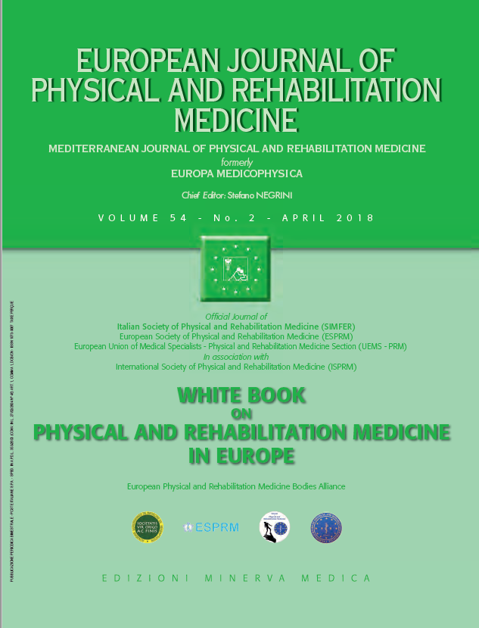
BACKGROUND OF PHYSICAL AND REHABILITATION MEDICINE Why rehabilitation is needed by individual and society
2
European Physical and Rehabilitation Medicine Bodies Alliance. White Book on Physical and Rehabilitation Medicine in Europe. Chapter 2. Why rehabilitation is needed by individual and society. Eur J Phys Rehabil Med. 2018 Apr;54(2):166-176. doi: 10.23736/S1973-9087.18.05145-6.

Slide 2
Introduction
This chapter describes the background to the context of PRM services - any planning of the latter has to take into account the burden of disability.
Specialists in PRM need to relate to this context.
Other doctors, healthcare professionals and service planners also need to know the background of PRM and why making a functional diagnosis and a management plan based on function is the core element of competence in PRM.

Slide 3
Epidemiological aspects - Demographic change in Europe
Europe’s population is growing to a total of 742.5 million, of whom 510 million live in the 28 member states of European Union.
The Union of European Medical Specialists (UEMS) includes the Greater European Space with 31 countries.
Life expectancy is also increasing among Europeans, an increased level of disability is seen, reflected by a growth in the burden of care and higher costs.
About 10% of Western Europe’s population experience a disability.
Survival from serious disease and trauma leaves an increasing number of people with complex problems and functional deficits.
Many of these people are young at the time of their event/injury and will survive for many decades.
There is also an expectation of good health in today’s society.
Rehabilitation is effective in reducing the burden of disability and in enhancing opportunities for people with disabilities.

Slide 4
Epidemiology of functioning and disability
Epidemiological studies have now started to address chronic disease as an entity, but have not yet properly tackled the concepts of functioning, participation and quality of life.
A modern approach is to deal with these problems by focusing on healthy life expectancy (HALE) and disability-adjusted life-years (DALY s).
Epidemiology in PRM should consider the:
resultant loss of functioning in terms of the ICF categories
natural history of functions, activity and participation
need for and access to resources for use in rehabilitation (human resources, facilities, equipment, materials)
access to the available PRM resources
The epidemiological data support the burden of long term conditions and highlights the need for rehabilitation in Europe.

Slide 5
Ethical aspects and human rights
The aim of this chapter is to highlight the progress in supporting human rights for people with disabilities.
It deals with two aspects: human rights as a societal approach (macro level) and an ethical approach of practicing medicine (micro level).
Human rights are playing an increasing role in the struggle to improve health.
They also have important implications for rehabilitation practitioners and researchers.
Specialists in the field must address the ethical issues concerning the principles & norms of proper professional conduct, including the actions taken in the care of patients and family members.
Clinicians should take note of lifestyle issues for persons with disabilities.

Slide 6
Ethical aspects and human rights
Human rights approach:
It is the norm in Europe (or should be) that persons with disabilities (PWD) live as citizens with full autonomy, inclusion, dignity and human rights.
Participation is fundamental and a central aspect of this is access to society (includes physical access).
The Council of Europe has also published a series of reports and documents on human rights for people with disabilities, with aims to:
improve the quality of life of PWD
adopt measures aimed at improving quality of life of PWD
develop an action plan in order to achieve these goals
allow equity of access to employment as a key element
adopt innovative approaches, as persons with impairments live longer
create activities to enable a good state of physical and mental health in the later stages of life
strengthen supportive structures around PWD in need of support
promote the provision of quality of services
develop programs and resources to meet the needs of PWD

Slide 7
Disability Rights legislation
2005 UN Convention on Human Rights
2005 Resolution on „Disability, including Prevention, Management and Rehabilitation”
2006 UN Convention on Rights of Persons with Disabilities (UNCRPD)
2011 World Report on Disability
Global Disability Action Plan 2014-2021: „Better health for all people with disabilities.“
PRM and health services support a human rights approach to the practice of rehabilitation and PRM services.
They should also enshrine professional values and standards, medical education and training on ethics and human rights and advocacy, and encourage education among PWD, influencing policymakers and set advocacy assistance.

Slide 8
From a human rights perspective, rehabilitation practice imposes essential standards of healthcare services, which should be:
accessible from a physical and information perspective
non-discriminatory
affordable
acceptable from an ethical and cultural aspect
scientifically and medically appropriate and of the highest quality
The primary goal of health care policy is to maximize the health of the population within the limits of the available resources, and within an ethical framework built on equity and solidarity principles.
Innovative technologies that offer a therapeutic benefit should be made available at an acceptable cost.
The WHO regards disability as a human rights issue, a public health issue and a development issue.

Slide 9
Applying the principles of (medical) ethics
The adoption of human rights as the driving force for an inclusive policy and medical ethics is the underlying principle of patient centered rehabilitation care and PRM practice.
Conceptual choices made by society and health authorities may influence decisions with regard to persons with disabilities.
UNCRPD describes the purpose of the convention: to promote, protect and ensure the full and equal enjoyment of all human rights and fundamental freedoms by all people with PWD, and to promote respect for their inherent dignity.
The UNCRPD is legally binding and engages states to organise, strengthen and extend comprehensive habilitation and rehabilitation services and programs.
All of these are enshrined in PRM practice and are supported by PRM physicians, and rehabilitation has thus become the key health strategy of the 21st century.

Slide 10
Rehabilitation and health systems
Access to and funding of rehabilitation services vary from country to country.
Access to rehabilitation interventions is governed by prescription through a PRM physician.
Payers and commissioners of healthcare need to be aware of the value of specialist treatments, which require a multi-professional team as opposed to a single practitioner.
PRM interventions are covered by a public insurance package, especially for specialist rehabilitation in acute settings; however, almost everywhere there is an out of pocket supplement for the patient, usually largest in more chronic and long-term care.
Post-acute PRM programs and physical therapy can be limited in duration or the number of sessions, but most of the variability exists in long-term rehabilitation - this seems to originate from historical differences.
Acute PRM services (inpatient and outpatient) are generally embedded in acute/general hospitals or in private practice (outpatient). Post-acute services are provided in general as well as in specific hospitals/centers, while long-term services are mainly organized in specific facilities, sometimes depending on social service rather than healthcare.

Slide 11
Economic burden of disability - The cost of disability
The true extent of the numbers of people with severe and moderately severe disability is difficult to determine.
In order to understand better, we must use the ICF definition of disability.
Direct costs can be classified into two categories:
the additional costs encountered by disabled persons and their families for daily living standards
the disability benefits provided from governments
The European Commission highlighted areas for joint action between the EU and EU member states in the European Disability Strategy 2010-2020:
accessibility
participation
equality
employment
education and training
social protection
health, and External Action

Slide 12
The cost of disability

Slide 13
The role of rehabilitation in reducing the cost of disability
Rehabilitation has a pivotal role in reducing the cost of disability via promoting functional recovery and increasing the function with a management of environmental factors.
Cost-efficiency outcomes extend to rehabilitation in a variety of settings.
There are also benefits in terms of perceived disability, significantly lower hours of sickness absence, when a coordinated and tailored vocational rehabilitation (VR) program is delivered by a multiprofessional team working in a collaborative way under the lead of a PRM physician, when compared to the controls in those with musculoskeletal disorders.
Rehabilitation interventions may result in savings other health care or social services costs through maintaining productivity, which had been lost due to the underlying health condition or disability.

Slide 14
Effects of lack of rehabilitation
Money spent on rehabilitation is recovered with five to nine-fold savings and rehabilitation is effective in all phases of health conditions.
Specialized rehabilitation (as delivered by PRM services) is highly cost-efficient for all neurological conditions.
The lives of people with persisting disabilities and their families can be enhanced by rehabilitation, but, more importantly, the consequence of them not having rehabilitation may be to reduce independent functioning and quality of life.
In the absence of rehabilitation complications and loss of function may occur and discharge may be delayed.

Slide 15
The following may be found in the absence of rehabilitation for a variety of conditions:
immobility including weakness, cardio-respiratory impairment, muscle wasting, pressure sores, spasticity, contractures and osteoporosis
pain
nutritional problems
swallowing problems
bladder and bowel problems (constipation and incontinence)
communication problems
cognitive problems and an inability to benefit from learning
mood and behavioral problems
ill-health and systemic illness from a variety of causes, e.g. urinary tract and cardio respiratory problems, diabetes mellitus
complications of underlying conditions

Slide 16
PRM services need to be involved in longer-term follow-up of patients, as they move into living in the community, in order to prevent:
secondary health problems and social isolation
carers becoming exhausted by the burden of care
general practitioners or social workers being called on unnecessarily
emergency admissions back to hospital
unnecessary placements in residential or nursing home care
inappropriate and untimely prescription of disability equipment
inability to update disability equipment in the light of advancing technology

Slide 17
For this paper, the collective authorship name of European PRM Bodies Alliance includes
European Academy of Rehabilitation Medicine (EARM),
European Society of Physical and Rehabilitation Medicine (ESPRM),
European Union of Medical Specialists PRM section (UEMS-PRM section),
European College of Physical and Rehabilitation Medicine (served by the UEMS-PRM Board).
The Editors: Anthony B Ward, Pedro Cantista, Maria Gabriella Ceravolo, Nicolas Christodoulou, Alain Delarque, Christoph Gutenbrunner, Carlotte Kiekens, Saša Moslavac, Enrique Varela-Donoso, Mauro Zampolini, Stefano Negrini.
The contributors: Pedro Cantista, Carlotte Kiekens, Anthony B Ward, Mauro Zampolini Karol Hornáček, Aydan Oral, Lloyd Bradley, Rory O`Connor, Christoph Gutenbrunner, Andrew J. Haig, Géraldine Jacquemin, Vera Neumann, Peter Takáč.

