Slide 1
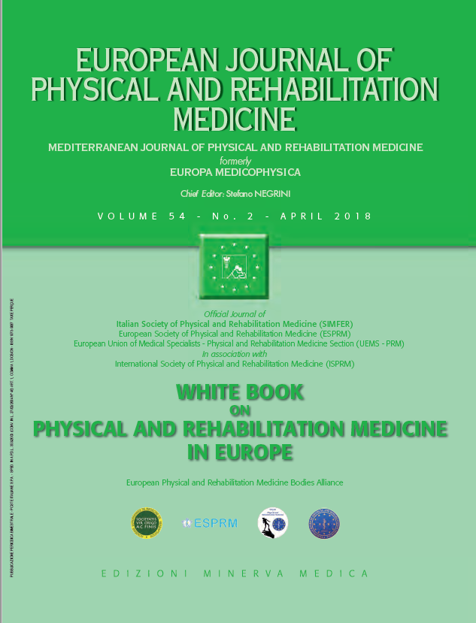
BACKGROUND OF PHYSICAL AND REHABILITATION MEDICINE Definitions and concepts of Physical and Rehabilitation Medicine
1
European Physical and Rehabilitation Medicine Bodies Alliance. White Book on Physical and Rehabilitation Medicine (PRM) in Europe. Chapter 1. Definitions and concepts of PRM. Eur J Phys Rehabil Med. 2018 Apr;54(2):156-165. doi:10.23736/S1973-9087.18.05144-4.

Slide 2
Introduction
Physical and Rehabilitation Medicine is the primary medical specialty responsible for the prevention, medical diagnosis, treatment and rehabilitation management of persons of all ages with disabling health conditions and their co-morbidities, specifically addressing their impairments and activity limitations in order to facilitate their physical and cognitive functioning (including behavior), participation (including quality of life) and modifying personal and environmental factors.
Whereas:
Functioning is all that human bodies do and the actions that people perform.
Disability is the problem a person has performing the actions that he or she needs and wants to do, because of how an underlying health condition affects his or her performance in his or her actual environment.
Rehabilitation is a set of measures that assist individuals, who experience or are likely to experience disability, to achieve and maintain optimum functioning in interaction with their environments.

Slide 3
Functioning, WHO’s health information reference
International Classification of Diseases (ICD) is a universal reference system for recording mortality and morbidity.
ICD 11 will also allow for the description of both the biomedical character and the impact of health conditions.
In 2001, the World Health Assembly endorsed the International Classification of Functioning, Disability and Health (ICF):
in terms of which the lived experience of health can be operationalized at the individual and population levels
take into account the environment in which they live and their personal factors
is an information reference system for the standardized description of health, functioning and disability at all levels useful to:
policy makers who aim to shape the health system
researchers who aim to explain and influence functioning

Slide 4
Functioning, WHO’s operationalization of health
Functioning is all that human bodies do and the actions that people perform.
Functioning domains are partitioned into the dimensions of Body Functions and Structures, Activities and Participation, organized in terms of a spectrum from simple to complex.
Each of the ICF functioning domains is conceived as a continuum, from total absence of functioning to full functioning.
While functioning increases during a person’s early years, it will decrease in consequence of injuries and diseases and ultimately with ageing.
It is therefore possible to construct representative trajectories of ageing, in light of the occurrence of specific health conditions and comorbidities.

Slide 5
The framework of functioning and disability in the International Classification of Functioning, Disability and Health

Slide 6
Practical tools to implement the ICF in clinical practice, service provision and payment, policy and research
Practical tools
facilitate the ICF application for a wide range of purposes
make it possible to report the data collected using a common metric
ICF domains to document? Examples:
ICF Generic Set
the ICF Rehabilitation Set
ICF Core Set for a specific health condition
Perspective to take:
capacity, or:
What data collection tools will apply to our purpose?
What metric approach do we wish to use for reporting?

Slide 7
The ICF and functioning in Rehabilitation
The ICF is fundamental to rehabilitation and to the field of PRM.
Objective of both is: to optimize a person’s functioning and thereby increase his or her quality of life through treatment of the intrinsic health aspects or by means of enabling changes to his or her environment.
PRM’s goal is to translate a person’s intrinsic capacity or biological health into actual performance in interaction with the environment and personal factors.
Functioning is the starting point of clinical assessment, the anticipated outcome of intervention, and the basis for quality management of interventions.

Slide 8
The ICF and functioning in Rehabilitation
With the ICF, intervention targets and goals can be specified in terms of the person’s functioning level, the underlying health condition and comorbidities, and the relevant personal and environmental factors.
Interventions themselves can be specified using the International Classification of Health Interventions (ICHI).
The joint use of the ICF, the ICD and ICHI thereby allows for a comprehensive standardized coding of the full rehabilitation cycle.
In order to foster the implementation of the ICF in day-to-day rehabilitation practice, the UEMS-PRM Section and Board is leading a European effort towards a system-wide implementation of the ICF in PRM, rehabilitation and health care at large in interaction with governments, non-governmental actors and the private sector.
The effort is aligned with the International Society of Physical and Rehabilitation Medicine (ISPRM)’s work-plan with WHO.

Slide 9
Disability and WHO’s ICF
Disability - a problem a person has performing the actions he or she needs and wants to do because of how an underlying health condition — a disease, injury or even ageing — affects his or her performance in the person’s actual environment.
Environmental factors can act either as barriers (limiting performance) or facilitators (enhancing performance).
The ICF clearly distinguishes between problems that result entirely from the underlying health condition (capacity) from problems arising from the interaction between capacity and the environment and personal factors (performance).
These health strategies address, and attempt to eliminate or ameliorate the experience of disability.

Slide 10
Disability epidemiology
The challenge - to reach a consensus about the definition of disability.
The current state of the epidemiology of disability tends to confuse two experiences: the capacity perspective and the performance perspective. Both perspectives are important.
Disability Action Plan - WHO has taken the step to refine disability epidemiology by developing a Model Disability Survey that clearly distinguishes the capacity from the performance perspectives.

Slide 11
Disability interventions
Limitations in the capacity to perform in some domain such as in mobility or major life activities may be considerably reduced by appropriate assistive devices and other environmental facilitators.
These rehabilitation interventions require us to be able to translate the potential gains from capacity improvement and environmental changes on the actual performance of actions.
These interventions must focus on the interaction between person and environment.
The effectiveness and quality of rehabilitation interventions must be assessed in the actual outcome of this interaction.

Slide 12
Disability evaluation
Disability is not the opposite of functioning, but rather a range of functioning.
There is no single point on the continuum where, for every domain, functioning ends and disability begins.
Good clinical practice recognizes that the level of functioning that a person experiences as disability will be shaped by personal and cultural expectations.
Person-centered care requires that these expectations be respected.

Slide 13
Disability – two societal perspectives
Disability is clearly a universal feature of the human condition, in the sense that everyone will experience or is at risk of experiencing limitations of capacity and problems of performance.
Ageing itself is a process of accumulating impairments across many domains.
For socio-political reasons, we socially identify a group of individuals as ‘persons with disabilities’ as, effectively, a minority group who have been marginalized from the mainstream and denied, to one extent or another, full inclusion and effective participation in society.
The focus of rehabilitation is on the universal sense of disability - increasingly rehabilitation interventions are focused not only on severe assaults on functioning, such as stroke and spinal cord injury, but also on situations of multiple, but relatively mild or moderate disabilities associated with the ageing process.
The future challenges of rehabilitation:
increased burden of care
increased costs of health and social care
greater social expectations of good health
the need to create complex interventions strategies that respond to the entire experience of disability
the evaluation of the outcomes of these interventions
The focus is primarily on the social goal of full inclusion in line with basic human rights - Convention on the Rights of Persons with Disabilities.

Slide 14
Rehabilitation is a main health strategy of the health system
Rehabilitation is:
one of the five health strategies
an essential health strategy in primary care which aims to address „the main health problems in the community” by „providing promotive, preventive, curative and rehabilitative services”

Slide 15
The emergence of rehabilitation as the key health strategy of the 21st century
The population was ageing because of better health care and increased survival, and the non-communicable chronic diseases, at least in the high resource world.
The primary health strategy is not so much to cure as to optimize the functioning of people.
This is the natural domain of rehabilitation, whose objective is to optimize intrinsic health capacity and enhance facilitating environments so that, in interaction, the outcome is more functioning and less disability.
Demographic and epidemiological realities have socially transformed rehabilitation into the key health strategy of the 21st century.

Slide 16
Defining rehabilitation based on the ICF
ICF - based conceptual description of rehabilitation published in 2007 by the Professional Practice Committee of the UEMS-PRM Section was used as the definition of rehabilitation in the World Health Organization’s World Report on Disability (WRD) launched in 2011.
ISPRM developed and endorsed an updated version of this conceptual description.
It has also served as the basis for derived conceptualizations for specific applications:
for the medical specialty PRM
for specific areas of PRM
for vocational rehabilitation

Slide 17
For this paper, the collective authorship name of European PRM Bodies Alliance includes
European Academy of Rehabilitation Medicine (EARM),
European Society of Physical and Rehabilitation Medicine (ESPRM),
European Union of Medical Specialists PRM section (UEMS-PRM section),
European College of Physical and Rehabilitation Medicine (served by the UEMS-PRM Board).
The Editors: Pedro Cantista, Maria Gabriella Ceravolo, Nicolas Christodoulou, Alain Delarque, Christoph Gutenbrunner, Carlotte Kiekens, Saša Moslavac, Enrique Varela-Donoso, Anthony B Ward, Mauro Zampolini, Stefano Negrini.
The contributors: Pedro Cantista, Gerold Stucki, Jerome Bickenbach, Christoph Gutenbrunner, António Pinto Camelo, Carlotte Kiekens, Juan Carlos Miangollara, Daiana Popa, Francisco Sampaio, Pedro Soares Branco.

