Slide 1
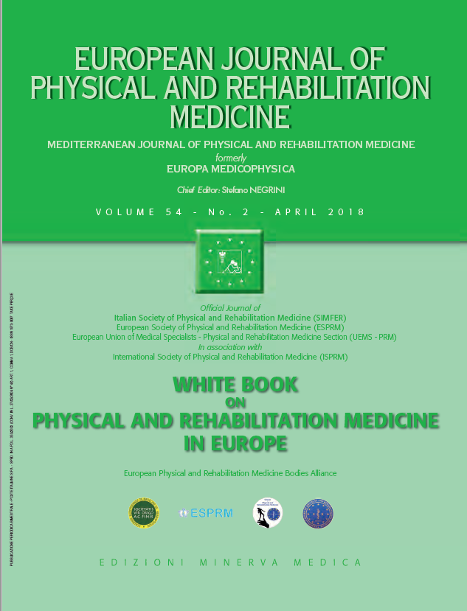
THE WHITE BOOK ON PHYSICAL AND REHABILITATION MEDICINE IN EUROPE Introductions, Executive Summary, and Methodology
European Physical and Rehabilitation Medicine Bodies Alliance. White Book on Physical and Rehabilitation Medicine (PRM) in Europe. Introductions, Executive Summary, and Methodology. Eur J Phys Rehabil Med. 2018 Apr;54(2):125-155. doi: 10.23736/S1973-9087.18.05143-2.

Slide 2
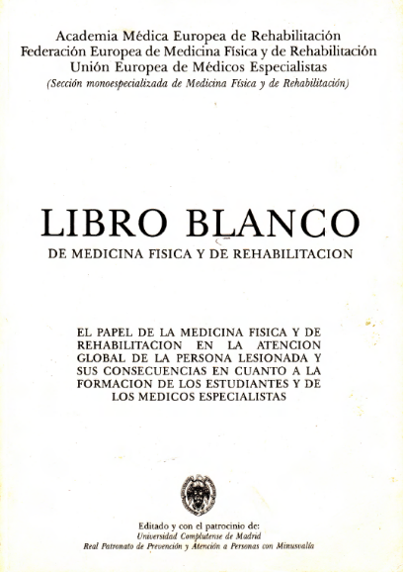
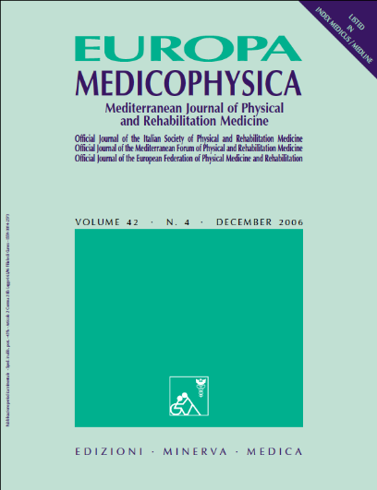
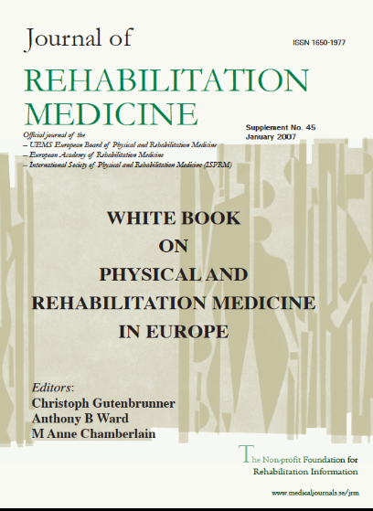
History of the White Book
First Edition (1989)
Book published by Universidad Complutense de Madrid
4 languages: English, French, Italian, Spanish
Author: EARM with UEMS-PRM Section
Second Edition (2006-7)
Published in Special issues of 2 journals (in PubMed)
Europa Medicophysica (now European Journal of Physical and Rehabilitation Mecine)
Journal of Rehabilitation Medicine
English
Authors: EARM and UEMS PRM Section and Board with ESPRM
Notes:
1

Slide 3
Aim of the third edition of the White Book
Describe the work of the PRM specialty and its PRM specialists in:
A changing world of health care systems and shrinking resources;
Reacting and contributing to medical innovation;
Developing strategies to meet the challenge of scientific and technological advances;
Dealing with changing perspectives of disability
Promoting and facilitating the participation of people with disabilities in everyday life and autonomy
Being a didactic reference for PRM practice and academic life to young health professionals (especially medical doctors in training)
Having a European perspective.
Notes:
1

Slide 4
Authors and copyright holders
European PRM Bodies Alliance
European Academy of Rehabilitation Medicine (EARM)
European Society of Physical and Rehabilitation Medicine (ESPRM)
Physical and Rehabilitation Medicine Section of the European Union of Medical Specialists (UEMS-PRM Section)
European College of Physical and Rehabilitation Medicine (served by the UEMS-PRM Board)
Stakeholders
All National PRM Societies
Notes:
1

Slide 5
Steering Committe of PRM Bodies
European Academy of Rehabilitation Medicine (EARM)
Christoph Gutenbrunner (Ger)
Anthony Ward (UK)
European Society of Physical and Rehabilitation Medicine (ESPRM)
Pedro Cantista (Por)
Gordana Devecerski (Ser)
UEMS Physical and Rehabilitation Medicine Board
Alvydas Juoucevicius (Ltv)
Sasa Moslavac (Cro) (Secretary)
UEMS Physical and Rehabilitation Medicine Section
Stefano Negrini (Ita) (Coordinator)
Enrique Varela Donoso (Esp)
Notes:
1

Slide 6
Writing and review
Writing
First authors: draft and final revision
Co-authors: contribution and revision
Review
4 formal review stages (internal/external reviewers, delegates & acamedicians, editors)
5 Consesus Conferences (delegates & acamedicians, editors)
4 Revisions (editors)
4 official votes (4 European Bodies)

Slide 7
117 people from 35 countries
Aguiar-Branco Catarina (Portugal)
Antunes Filipe (Portugal)
Avellanet Mercè (Andorra)
Bardot Philippe (France)
Barotsis Nikolaos (Greece)
Basaglia Nino (Italy)
Bertolini Carlo (Italy)
Bickenbach Jerome (Switzerland)
Boldrini Paolo (Italy) (Italy)
Borg Kristian (Sweden)
Boyer François (France) (France)
Bradley Lloyd (UK)
Brocard Frédéric (France)
Burn John (UK) (UK)
Cantista Pedro (Portugal)
Castellote Juan (Spain)
Ceravolo Maria (Italy)
Chaler Joaquim (Spain)
Chamberlain Anne (UK)
Christodoulou Nicolas (Cyprus)
Damjan Hermina (Slovenia)
Delargy Mark (Ireland)
Delarque Alain (France)
Devečerski Gordana (Serbia)
Didier Jean-Pierre (France)
Dy Rochelle T. (USA)
Fazekas Gabor (Hungary)
Foti Calogero (Italy)
Franchignoni Franco (Italy)
Frischknecht Rolf (Switzerland)
Frontera Walter (USA)
Garreta Figuera (Spain)
Geertzen Jan HB (The Netherlands)
Gimigliano Francesca (Italy)
Giustini Alessandro (Italy)
Glaesener Jean-Jacques (Germany)
Grabljevec Klemen (Slovenia)
Grimby Gunnar (Sweden)
Gutenbrunner Christoph (Germany)
Haig Andrew J. (USA)
Hornáček Karol (Slovak Republic)
Ilieva Elena (Bulgaria) (Bulgaria)
Imamura Marta (Brasil)
Jacquemin Géraldine (Canada)
Jandric Slavica (Bosnia and Herzegovina)
Janssen Wim (The Netherlands) (The Netherlands)
Juocevicius Alvydas (Lithuania)
Kiekens Carlotte (Belgium)
Küçükdeveci Ayşe A. (Turkey)
Kujawa Jolanta (Poland)
Lains Jorge (Portugal)
Laxe Sara (Spain)
Lejeune Thierry (Belgium)
Li Jianan First (China)
Li Leonard (Hong Kong)
Marinček Črt (Slovenia)
Martínez Assucena María Amparo (Spain)
McElligott Jacinta (Ireland)
McNamara Angela (Ireland)
Miangolarra-Page JC (Spain)
Michail Xanthi (Greece)
Michel Carine (France)
Moslavac Saša (Croatia)
Negrini Stefano (Italy)
Neumann Vera (UK)
Nulle Anda (Latvia)
Nunes Renato (Portugal)
O’Connor Rory J (UK)
Oral Aydan (Turkey)
Özçakar Levent (Turkey)
Padua Luca (Italy)
Paris Diderot (France)
Páscoa Pinheiro João (Portugal)
Paternostro-Sluga Tatiana (Austria)
Paysant Jean (France)
Pérennou Dominic (France)
Pinto Camelo (Portugal)
Pistarini Caterina (Italy)
Playford Diane (UK)
Popa Daiana (Romania)
Quittan Michael (Austria)
Rapidi Christina-Anastasia (Greece)
Rapin Amandine (France)
Rimbaut Steven (Belgium)
Rode Gilles (France)
Rossetti Yves (France)
Rosulescu Eugenia (Romania)
Sampaio Francisco (Portugal)
Schuhfried Othmar (Austria)
Singh Rajiv (UK)
Sjölund Bengt (Denmark)
Smania Nicola (Italy)
Smit Christof A.J. (The Netherlands)
Smolenski Ulrich Christian (Germany)
Soares Branco (Portugal)
Stam Henk (The Netherlands)
Stibrant Sunnerhagen Katharina (Sweden)
Stucki Gerold (Switzerland)
Takáč Peter (Slovak Republic)
Tang Simon F (Taiwan)
Tederko Piotr (Poland)
Tennant Alan (Switzerland)
Tesio Luigi (Italy)
Thevenon André (France)
Valero-Alcaide Raquel (Spain)
van Nes Ilse J.W. (The Netherlands)
Varela-Donoso Enrique (Spain)
Vetra Aivars (Latvia)
Vlak Tonko (Croatia)
Votava Jiri (Czech Republic)
Wade Derick T (UK)
Ward Anthony B (UK)
Weinstein Stuart M. (USA)
Wever Daniel (The Netherlands)
Winkelmann Andreas (Germany)
Yelnik Alain (France)
Zampolini Mauro (Italy)

Slide 8
11 Editors (9 countries)
Stefano Negrini (Italy) (Coordinator)
Sasa Moslavac (Croatia) (Secretary)
Pedro Cantista (Portugal)
Maria Gabriella Ceravolo (Italy)
Nicolas Christodoulou (Cyprus)
Alain Delarque (France)
Christoph Gutenbrunner (Germany)
Carlotte Kiekens (Belgium)
Enrique Varela Donoso (Espana)
Anthony Ward (UK)
Mauro Zampolini (Italy)
Notes:
1

Slide 9
38 first authors (22 countries)
Antunes Filipe (Portugal)
Boldrini Paolo (Italy)
Boyer François (France)
Burn John (UK)
Cantista Pedro (Portugal)
Ceravolo Maria Gabriella (Italy)
Christodoulou Nicolas (Cyprus)
Delarque Alain (France)
Devečerski Gordana (Serbia)
Didier Jean-Pierre (France)
Foti Calogero (Italy)
Franchignoni Franco (Italy)
Grimby Gunnar (Sweden)
Gutenbrunner Christoph (Germany)
Ilieva Elena (Bulgaria)
Janssen Wim (The Netherlands)
Juocevicius Alvydas (Lithuania)
Kiekens Carlotte (Belgium)
Küçükdeveci Ayşe (Turkey)
Lains Jorge (Portugal)
Laxe Sara (Spain)
McElligott Jacinta (Ireland)
McNamara Angela (Ireland)
Michail Xanthi (Greece)
Negrini Stefano (Italy)
Oral Aydan (Turkey)
Özçakar Levent (Turkey)
Quittan Michael (Austria)
Rapidi Christina-Anastasia (Greece)
Rode Gilles (France)
Singh Rajiv (UK)
Sjölund Bengt (Denmark)
Stam Henk (The Netherlands)
Stucki Gerold (Switzerland)
Takáč Peter (Slovak Republic)
Tederko Piotr (Poland)
Ward Anthony B (UK)
Zampolini Mauro (Italy)
Notes:
1

Slide 10
63 co-authors (24 countries)
Aguiar-Branco Catarina (Portugal)
Antunes Filipe (Portugal)
Bardot Philippe (France)
Barotsis Nikolaos (Greece)
Bertolini Carlo (Italy)
Bickenbach Jerome (Switzerland)
Borg Kristian (Sweden)
Cantista Pedro (Portugal)
Ceravolo Maria (Italy)
Chaler Joaquim (Spain)
Chamberlain Anne (UK)
Christodoulou Nicolas (Cyprus)
Delargy Mark (Ireland)
Delarque Alain (France)
Devečerski Gordana (Serbia)
Didier Jean-Pierre (France)
Foti Calogero (Italy)
Franchignoni Franco (Italy)
Giustini Alessandro (Italy)
Glaesener Jean-Jacques (Germany)
Grabljevec Klemen (Slovenia)
Grimby Gunnar (Sweden)
Gutenbrunner Christoph (Germany)
Hornáček Karol (Slovak Republic)
Jandric Slavica (Bosnia and Herzegovina)
Janssen Wim G.M. (The Netherlands)
Juocevicius Alvydas (Lithuania)
Kiekens Carlotte (Belgium)
Küçükdeveci Ayşe A. (Turkey)
Kujawa Jolanta (Poland)
Laxe Sara (Spain)
Marinček Črt (Slovenia)
McElligott Jacinta (Ireland)
McNamara Angela (Ireland)
Michail Xanthi (Greece)
Michel Carine (France)
Moslavac Saša (Croatia)
Negrini Stefano (Italy)
Nulle Anda (Latvia)
Nunes Renato (Portugal)
Oral Aydan (Turkey)
Páscoa Pinheiro João (Portugal)
Paysant Jean (France)
Pérennou Dominic (France)
Popa Daiana (Romania)
Rapin Amandine (France)
Rossetti Yves (France)
Rosulescu Eugenia (Romania)
Singh Rajiv (UK)
Smolenski Ulrich Christian (Germany)
Stam Henk (The Netherlands)
Stibrant Sunnerhagen Katharina (Sweden)
Takáč Peter (Slovak Republic)
Tesio Luigi (Italy)
Valero-Alcaide Raquel (Spain)
Varela-Donoso Enrique (Spain)
Vetra Aivars (Latvia)
Votava Jiri (Czech Republic)
Wade Derick T (UK)
Ward Anthony B (UK)
Wever Daniel (The Netherlands)
Winkelmann Andreas (Germany)
Zampolini Mauro (Italy)
Notes:
1

Slide 11
38 reviewers (24 countries)
Aguiar-Branco Catarina (Portugal)
Borg Kristian (Sweden)
Ceravolo Maria Gabriella (Italy) (Italy)
Christodoulou Nicolas (Cyprus) (Cyprus)
Damjan Hermina (Slovenia)
Delarque Alain (France)
Devečerski Gordana (Serbia) (Serbia)
Didier Jean-Pierre (France)
Fazekas Gabor (Hungary)
Foti Calogero (Italy) (Italy)
Frischknecht Rolf (Switzerland)
Giustini Alessandro (Italy)
Glaesener Jean-Jacques (Germany)
Gutenbrunner Christoph (Germany) (Germany)
Juocevicius Alvydas (Lithuania)
Kiekens Carlotte (Belgium) (Belgium)
Küçükdeveci Ayşe A. (Turkey)
Kujawa Jolanta (Poland)
Laxe Sara (Spain)
Lejeune Thierry (Belgium)
Moslavac Saša (Croatia)
Negrini Stefano (Italy)
Nunes Renato (Portugal)
Páscoa Pinheiro João (Portugal)
Paternostro-Sluga Tatiana (Austria)
Playford Diane (UK)
Popa Daiana (Romania)
Rapidi Christina-Anastasia (Greece)
Rode Gilles (France)
Sjölund Bengt (Denmark)
Stibrant Sunnerhagen Katharina (Sweden)
Stucki Gerold (Switzerland)
Takáč Peter (Slovak Republic)
Valero-Alcaide Raquel (Spain)
Vetra Aivars (Latvia)
Ward Anthony B (UK)
Wever Daniel (The Netherlands)
Zampolini Mauro (Italy)
Notes:
1

Slide 12
40 external reviewers (17 countries, 3 continents)
Avellanet Mercè (Andorra)
Basaglia Nino (Italy)
Bickenbach Jerome (Switzerland)
Bradley Lloyd (UK)
Brocard Frédéric (France)
Castellote Juan (Spain)
Dy Rochelle T. (USA)
Frontera Walter (USA)
Garreta Figuera (Spain)
Geertzen Jan HB (The Netherlands)
Gimigliano Francesca (Italy)
Haig Andrew J. (USA)
Imamura Marta (Brasil)
Jacquemin Géraldine (Canada)
Li Jianan First (China)
Li Leonard (Hong Kong)
Martínez Assucena María Amparo (Spain)
Miangolarra-Page JC (Spain)
Neumann Vera (UK)
O’Connor Rory J (UK)
Padua Luca (Italy)
Paris Diderot (France)
Pérennou Dominic (France)
Pinto Camelo (Portugal)
Pistarini Caterina (Italy)
Rimbaut Steven (Belgium)
Sampaio Francisco (Portugal)
Schuhfried Othmar (Austria)
Smania Nicola (Italy)
Smit Christof A.J. (The Netherlands)
Soares Branco (Portugal)
Tang Simon F (Taiwan)
Tennant Alan (Switzerland)
Tesio Luigi (Italy)
Thevenon André (France)
van Nes Ilse J.W. (The Netherlands)
Vlak Tonko (Croatia)
Weinstein Stuart M. (USA)
Yelnik Alain (France)
Notes:
1

Slide 13
Review process First stage
 | Review | Revision
First Consensus Conference (UEMS PRM Section Professional Practice Committee) | 25-8-2016 Prague (Czech Republic) On “Sensitive” paragraphs
First Review/revision | 30-9-2016 Internal and external reviewers on single paragraphs Delegates, academicians and editors on single paragraphs | 30-11-2016 Editors on their chapter
Second Review/revision | 15-12-2016 Editors on the whole WB

Slide 14
Review process Second stage
 | Review | Revision
Second Consensus Conference (editors) | 16/17-12-2016 Don Gnocchi Foundation Rovato (Brescia) - Italy On each single chapter | 7-1-2017 Editors on their chapter
Third Review/revision | 21-1-2017 Editors on the whole WB | 31-1-2017 Editors on their chapter
Third Consensus Conference (European PRM Bodies) | 9-3-2017 Munich (Germany) Delegates and academicians on the whole WB

Slide 15
Review process Third stage
 | Review | Revision
Fourth Review/revision | 15-3-2017 Comments of the Consensus Conference 15-4-2017 Collection of references from all delegates and academicians | 20-6-2017 editors on their chapter
Fourth Consensus Conference (editors) | 30-6/1-7-2017 University Hospital Leuven (Belgium) Collective by editors on each single chapter
August 2017 | Distribution of final paragraphs to all delegates and academicians

Slide 16
Review process Fourth stage
 | Review | Revision
Fifth Consensus Conference (UEMS PRM Section Professional Practice Committee) | 8-9-2017 Bratislava (Slovakia) On preface, executive summary, dictionary and methodology
September 2017 | ESPRM, UEMS-PRM Section and Board voting in Bratislava
November 2017 | EARM voting in Hannover
August-November 2017 | Uniformation and linguistic “International English” revision

Slide 17
Publication and launch
Publication April 2018
European Journal of Physical and Rehabilitation Medicine, 54 (2)
Official launch 1-6 May 2018
ESPRM Meeting in Vilnius with EARM and UEMS-PRM S&B
World Presentation July 2018
ISPRM Paris
Notes:
1

Slide 18
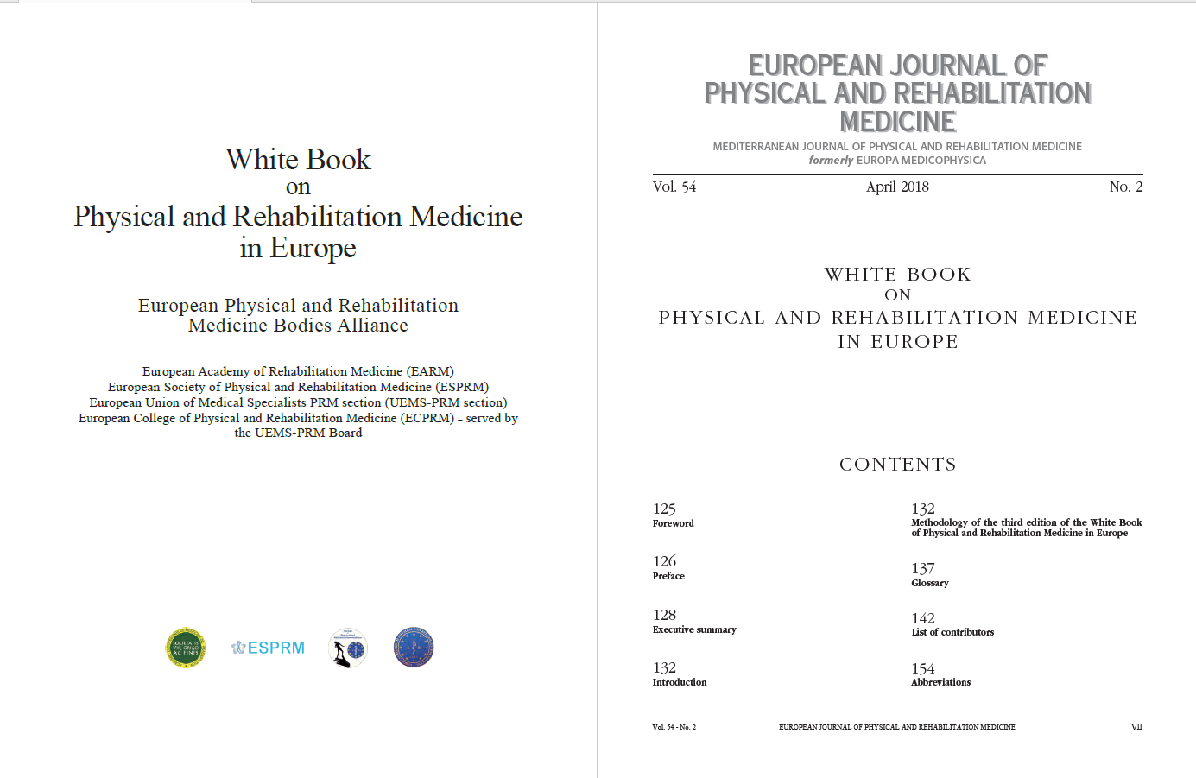

Slide 19
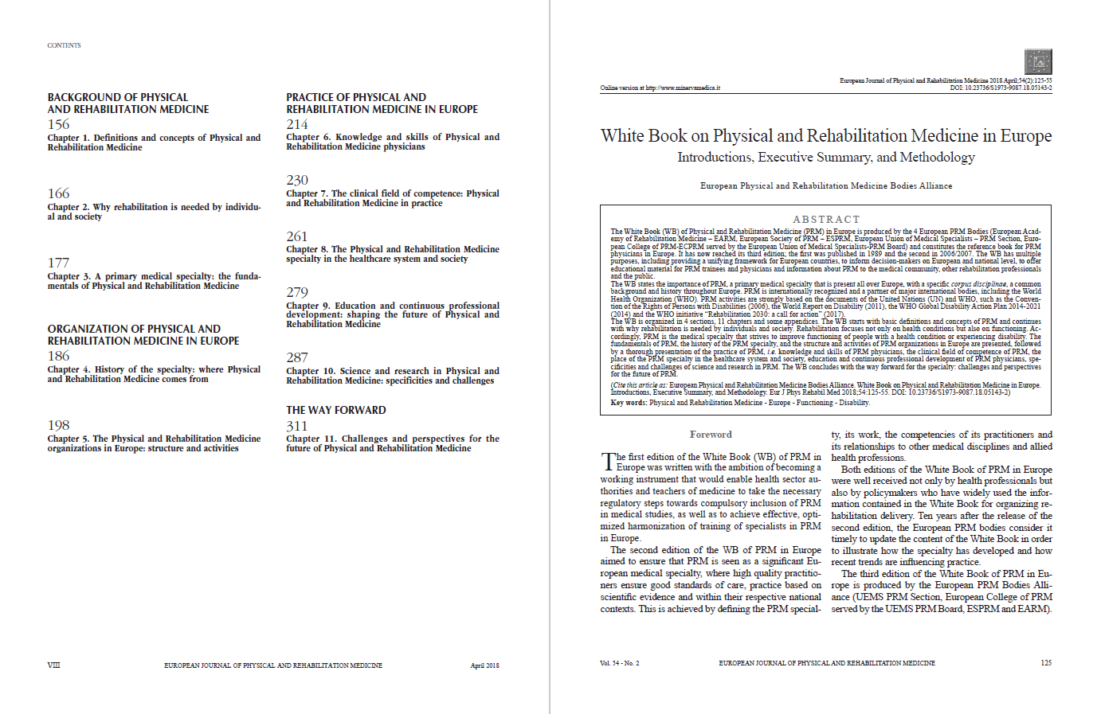

Slide 20
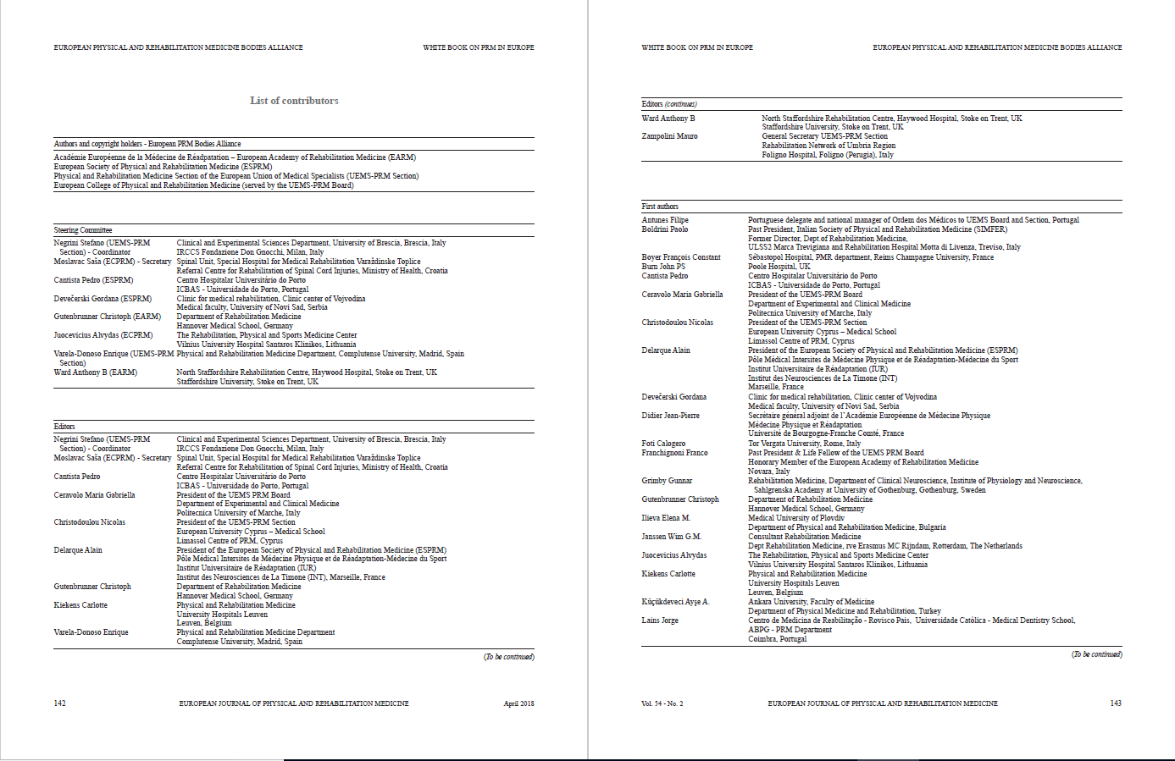

Slide 21
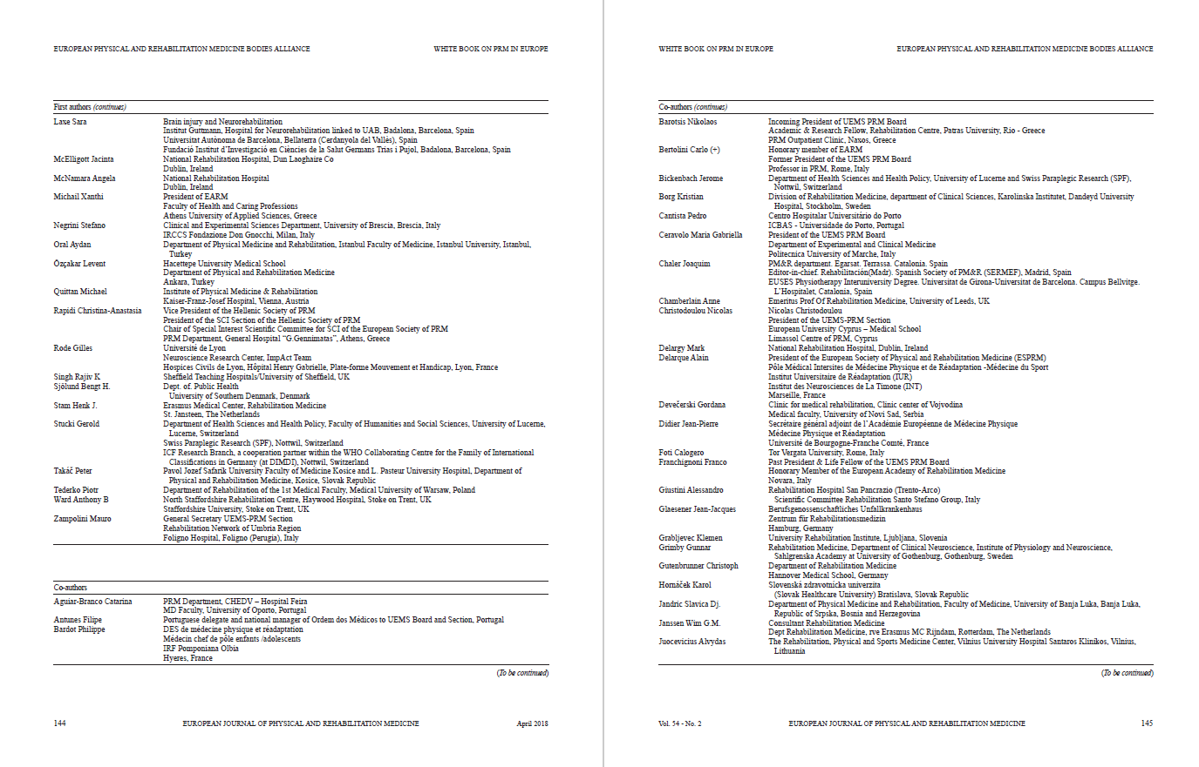

Slide 22
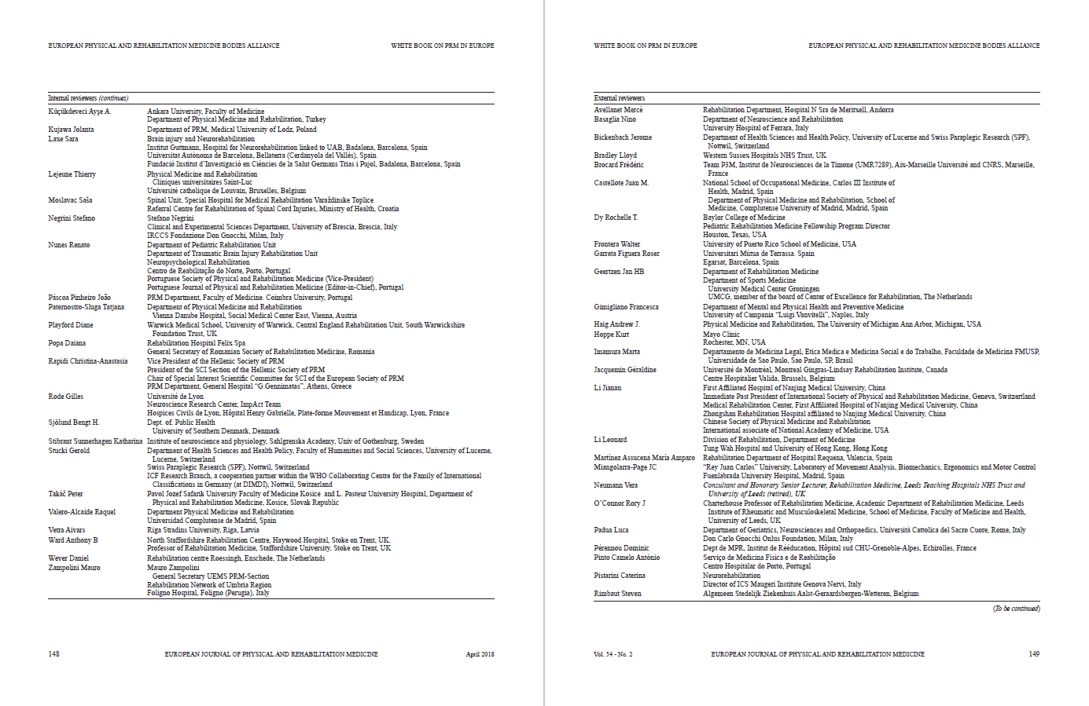

Slide 23
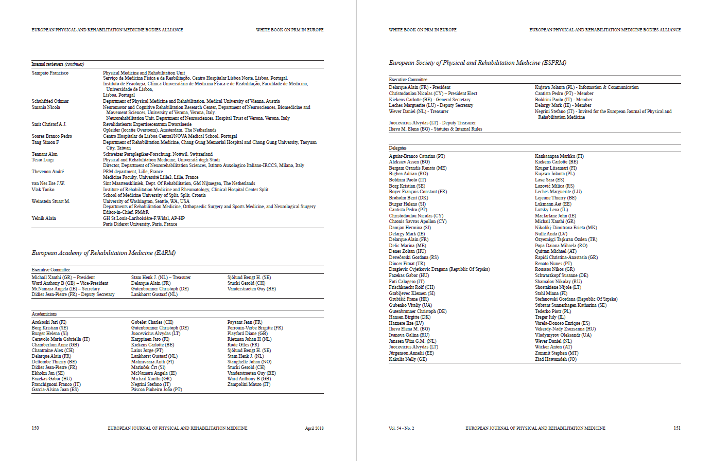

Slide 24
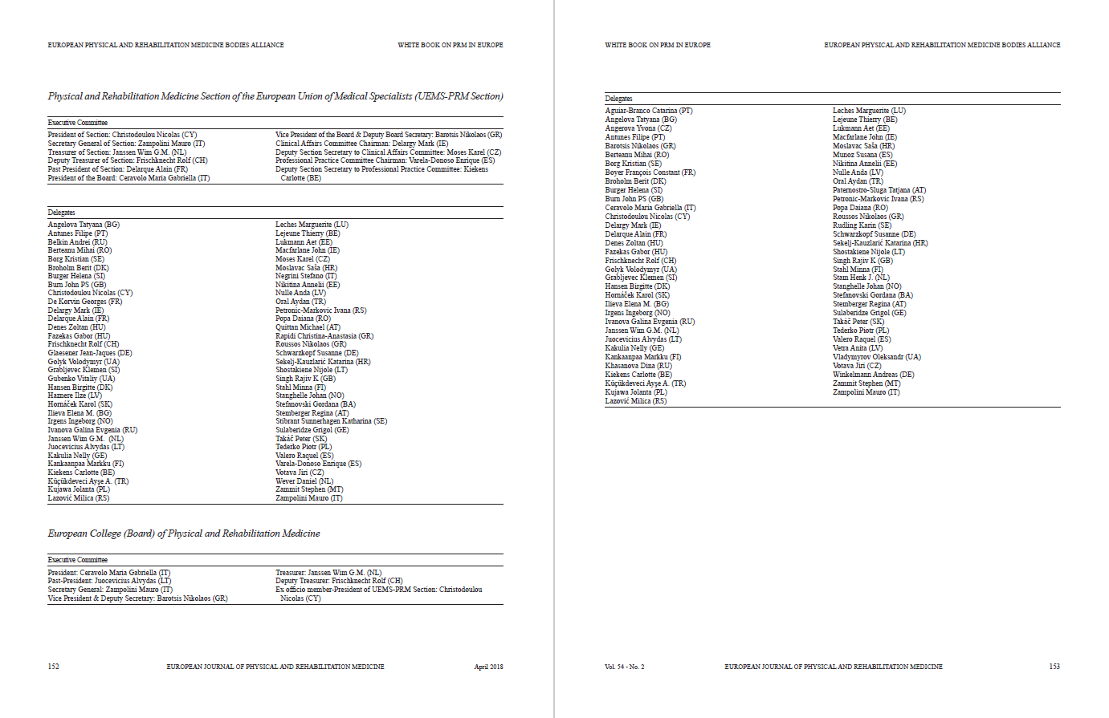

Slide 25
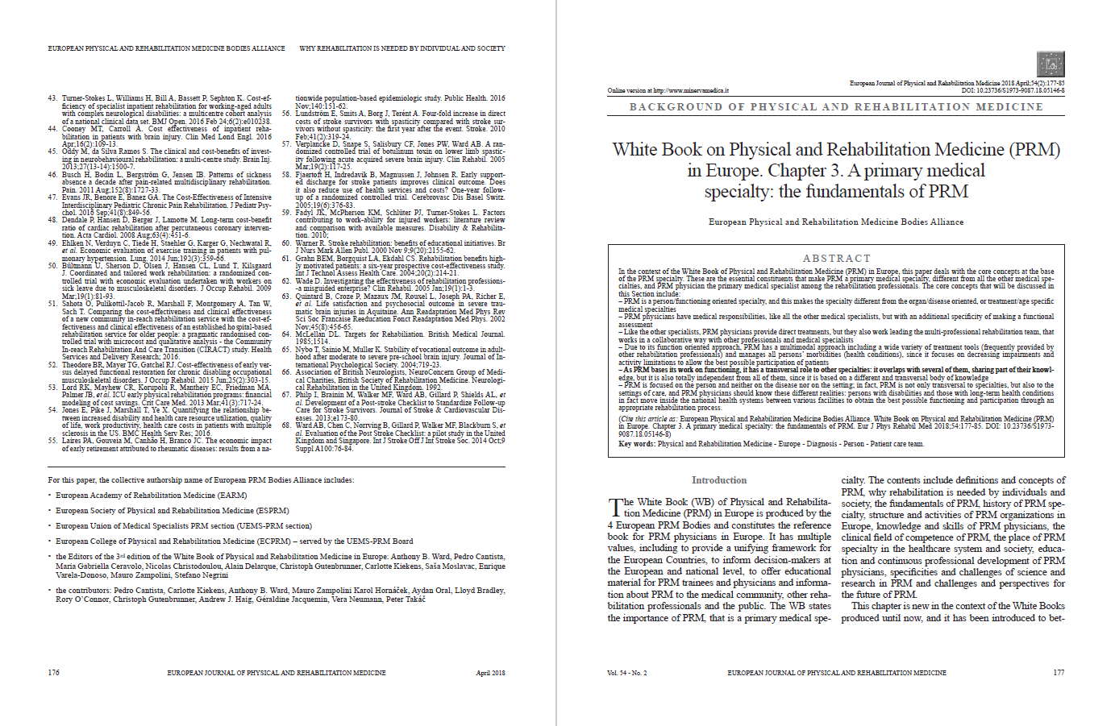

Slide 26
Part 1. Background of PRM
Definitions in PRM
The concepts and the specialty
Relevance of rehabilitation for people with disabling conditions and to society
Why rehabilitation is needed
PRM: a primary medical specialty
The core concepts of PRM
Notes:
1

Slide 27
1. Definitions in PRM. Concepts and specialty
Physical and Rehabilitation Medicine is the primary medical specialty responsible for the prevention, medical diagnosis, treatment and rehabilitation management of persons of all ages with disabling health conditions and their co-morbidities, specifically addressing their impairments and activity limitations in order to facilitate their physical and cognitive functioning (including behavior), participation (including quality of life) and modifying personal and environmental factors.
Other definitions presented in this chapter:
Functioning
Disability
Rehabilitation

Slide 28
2. Relevance of rehabilitation. Why is needed
Background to the context of PRM services:
Epidemiological Aspects of Functioning and Disability
Ethical Aspects and Human Rights
Rehabilitation and Health Systems
Economic Burden of Disability
Effects of Lack of Rehabilitation
Health care service planning accounts for the burden of disability among society and the chapter describes the justification for specialist rehabilitation, the background of PRM and why making a functional assesment and a management plan based on function is its core competence.

Slide 29
3. PRM a primary medical specialty
PRM is a person/functioning oriented specialty
PRM physicians have medical responsibilities, with an additional specificity of making a functional assessment
PRM physicians provide direct treatments, but they also work leading the multi-professional rehabilitation team
PRM has a multimodal approach
PRM has a transversal role to other specialties: it overlaps with several of them, sharing part of their knowledge, but it is also totally independent
PRM is focused on the person and neither on the disease nor on the setting

Slide 30
3. PRM a primary medical specialty
 | Classical medicine | PRM specialty
Overall approach | Disease oriented | Person/functioning oriented (holism)
Diagnosis and prognosis | Medical | Functional and medical
Treatments | One modality at a time | Multimodal
Morbidities | Single | Multiple
Professional approach | Individual | Multi-professional team

Slide 31
Part 2. PRM organization in Europe
Development of PRM specialty in Europe
Where PRM comes from
PRM activities and their representation in Europe
How PRM is organized
Notes:
1

Slide 32
4. History of the specialty
Different medical streams joined: balneology, gymnastic, use of physical agents.
Another important role has been played by the increasing number of people experiencing disability due to improvement of medicine
These evolutions happened in strict relationship with other specialties like cardiology, neurology, orthopaedics, pneumology, rheumatology, traumatology, creating a knowledge transversal to all of them.
PRM specialty has been gradually introduced in all the different European countries, however with no uniformity.
It is also described the origin of:
European Organizations and Bodies
Rehabilitation journals

Slide 33
5. PRM organizations in Europe
Section of Physical and Rehabilitation Medicine of the European Union of Medical Specialists (UEMS): professional competencies, quality management and accreditation
European College of PRM served by the UEMS PRM Board: education
European Society of Physical and Rehabilitation Medicine (ESPRM): research and a network of knowledge of PRM across Europe
European Academy of Rehabilitation Medicine: ethical issues
Regional Fora: Mediterranean, Baltic and North Sea
7 main journals dedicated to Rehabilitation with a growing impact factor.
Role across the world with a connection with the International Society of PRM and WHO

Slide 34
Part 3. Practice of PRM in Europe
Fundamentals of PRM
Knowledge, skill and abilities of PRM physicians
The Field of Competence of PRM
PRM in practice
PRM in Healthcare Systems
Place of PRM in Healthcare and Society
Education to PRM in Europe
Shaping the future of PRM
Science and research in PRM
Challenges and specificities of research in PRM
Notes:
1

Slide 35
6. Knowledge and skills of PRM physicians
Fundamentals of PRM from a physiological perspective, looking at the human mechanisms both physical and behavioral which are at the base of PRM physicians' work
Evolution driving to the actual fundamentals of PRM
Learning processes in Physical and Rehabilitation Medicine
Understanding the repair processes and using the compensatory processes in PRM for adaptation, habilitation and rehabilitation
Potential of recovery evaluation and prognosis in PRM
Management skills
Communication skills (including information and patient education)

Slide 36
7. The clinical field of competence of PRM
Scope of competencies of PRM
The rehabilitation process: assessment, goal-setting, intervention, and evaluation
Spectrum of health conditions treated by PRM physicians
Diagnosis of diseases in PRM (medical diagnosis)
Multidimensional assessment of functioning (functional assessment)
Interventions in PRM
Standardized PRM programs
Management skills and advisory role of PRM
Multi-professional collaboration and interdisciplinary teamwork
Ethics in clinical PRM practice
Outcomes of PRM interventions and programs

Slide 37
8. PRM in Healthcare systems and society
Implementation of PRM in Healthcare Systems
Capacity Building and Resource Allocation in PRM
Clinical Governance and Competencies in PRM
Different Phases of the PRM Process
PRM in acute settings
PRM in post-acute setting
PRM in long-term settings
Prevention, Health Maintenance and Health Promotion in PRM
Ethics and PRM Services

Slide 38
9. Education and CPD: shaping the future
Detailed information about the education and training of specialists and recommendations concerning the standards required at a European level
Theoretical knowledge necessary for the practice of PRM specialty and the core competencies to be achieved at the end of training established by the European PRM Board
Postgraduate PRM core curriculum is presented
Undergraduate training of medical students as a mandatory element for the growth of both PRM specialty and the medical community as a whole, mainly in front of the future challenges of the ageing population and the increase of disability in our continent.
Problems of continuing professional development and medical education in a PRM European perspective, with the role of the European Accreditation Council of Continuous Medical Education (EACCME) of UEMS.

Slide 39
10. Science and research in PRM
Biomedical research
Applied research
Translational medical research
Basic research and pre-clinical trials
Primary and secondary research
The European PRM schools, the European master and PhD program with their supporting research and clinical facilities, the European PRM organizations with their websites, the PRM scientific journals and European congresses, the Cochrane Rehabilitation field

Slide 40
Part 4. Conclusion
The way forward for PRM in Europe
Challenges and perspectives for the future of PRM
Notes:
1

Slide 41
11. Challenges & perspectives for the future
Big changes that Europe is facing in terms of demography, life expectancy, survival rates, disability burden, increasing prevalence of long-term health conditions, progress in technology, but also health costs and society changes in terms of requirements of wellness and quality of life together with health.
All these challenges combine with the specificities of PRM, that is the medical specialty focusing on the whole person and its functioning in the various health conditions, with the aim to guarantee the best possible participation through improvement of activities and reduction of impairments.
Consequences on future evolution of PRM
clinical practice
services
education
research
contribution to policy planning

Slide 42
For this paper, the collective authorship name of European PRM Bodies Alliance includes
European Academy of Rehabilitation Medicine (EARM),
European Society of Physical and Rehabilitation Medicine (ESPRM),
European Union of Medical Specialists PRM section (UEMS-PRM section),
European College of Physical and Rehabilitation Medicine (served by the UEMS-PRM Board).
The Editors: Stefano Negrini, Pedro Cantista, Maria Gabriella Ceravolo, Nicolas Christodoulou, Alain Delarque, Christoph Gutenbrunner, Carlotte Kiekens, Saša Moslavac, Enrique Varela-Donoso, Anthony B Ward, Mauro Zampolini.
The Presidents of the European PRM Bodies: Xanthi Michail (President of EARM), Alain Delarque (President of ESPRM), Nicolas Christodoulou (President of UEMS-PRM Section), Maria Gabriella Ceravolo (President of the ECPRM and UEMS-PRM Board).

